Slide 1
BARC Tube Bending Week 11

Slide 2
Possible Error Sources
Camera not perpendicular
Frame angle
Camera holder (on the frame) angle
Camera holder (on the camera) angle
Tube position
Tube holder angle
Horizontal calibration
Others
Camera intrinsic error
Lighting (color, strength)
Height from camera to tube
Background image

Slide 3
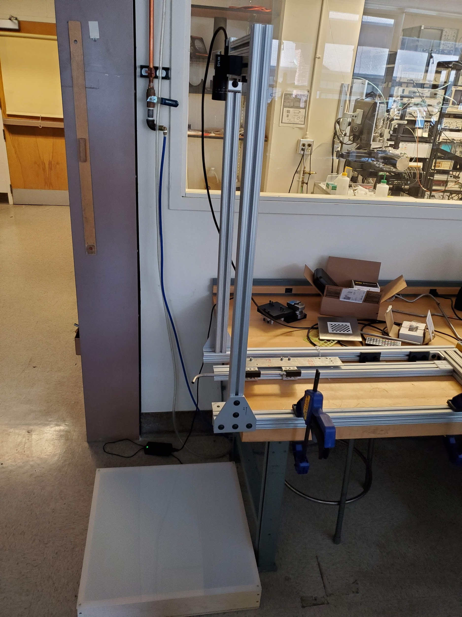
Possible Error Sources
Camera
Bend of Tube
LED box for lighting

Slide 4
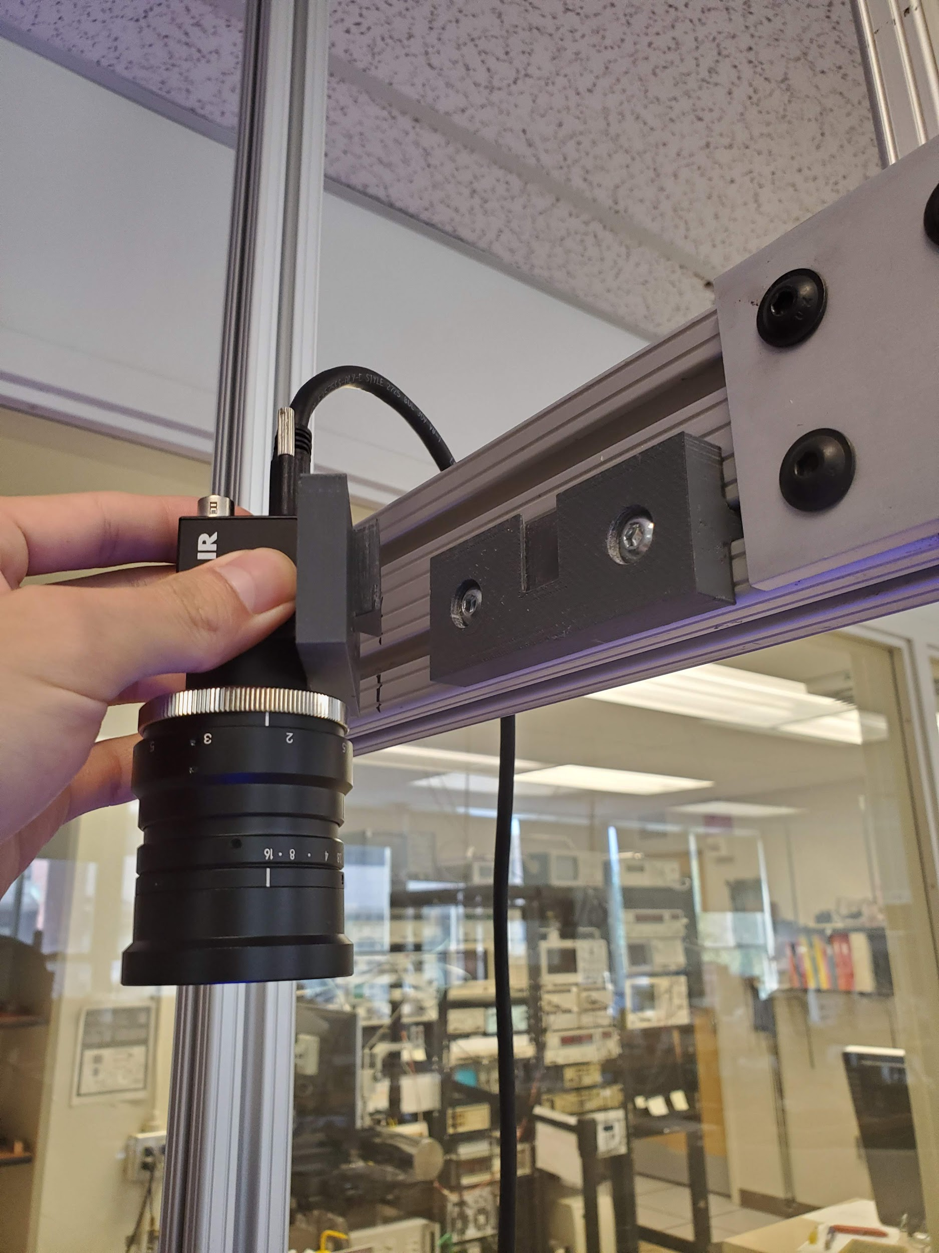
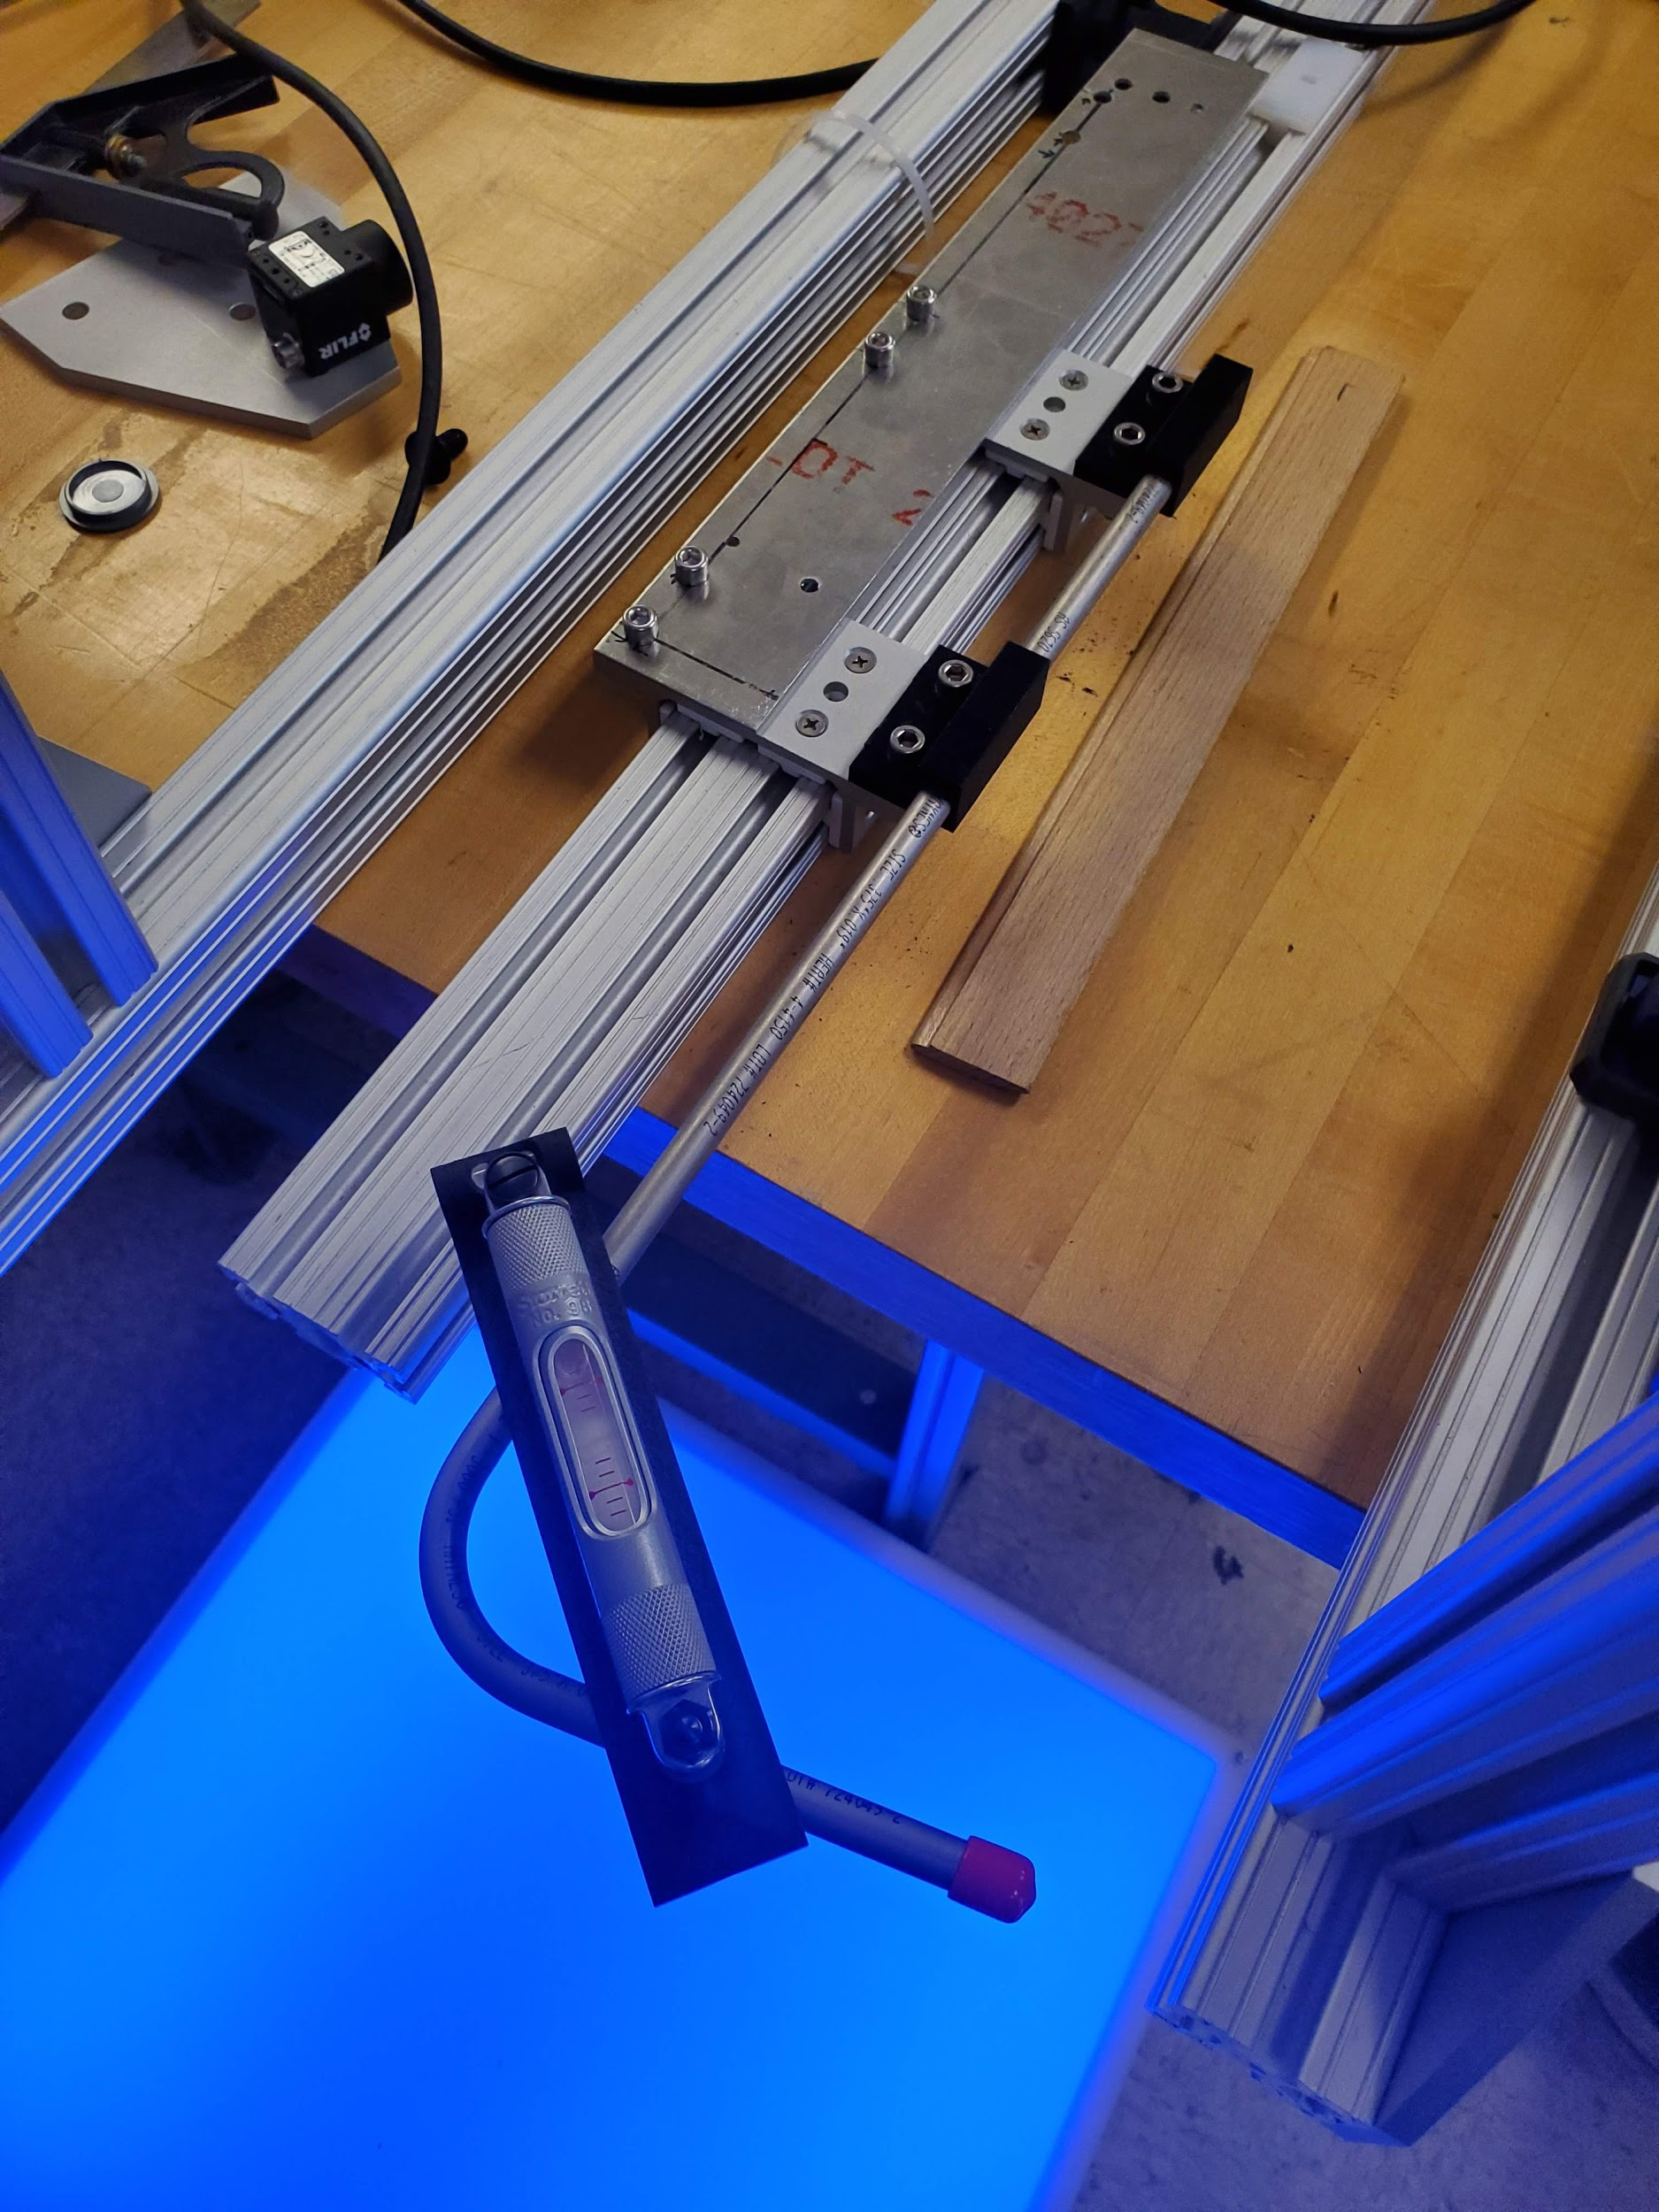
Possible Error Sources

Slide 5
To Eliminate Errors
Camera not perpendicular
Calibrated the frame, two camera holders. (Use Torpedo Level right now)
Tube position
Calibrated the tube to be horizontal. (Use Torpedo Level right now)
Others
Stronger backlight is preferred.
Retake the background image if the setting is changed.

Slide 6
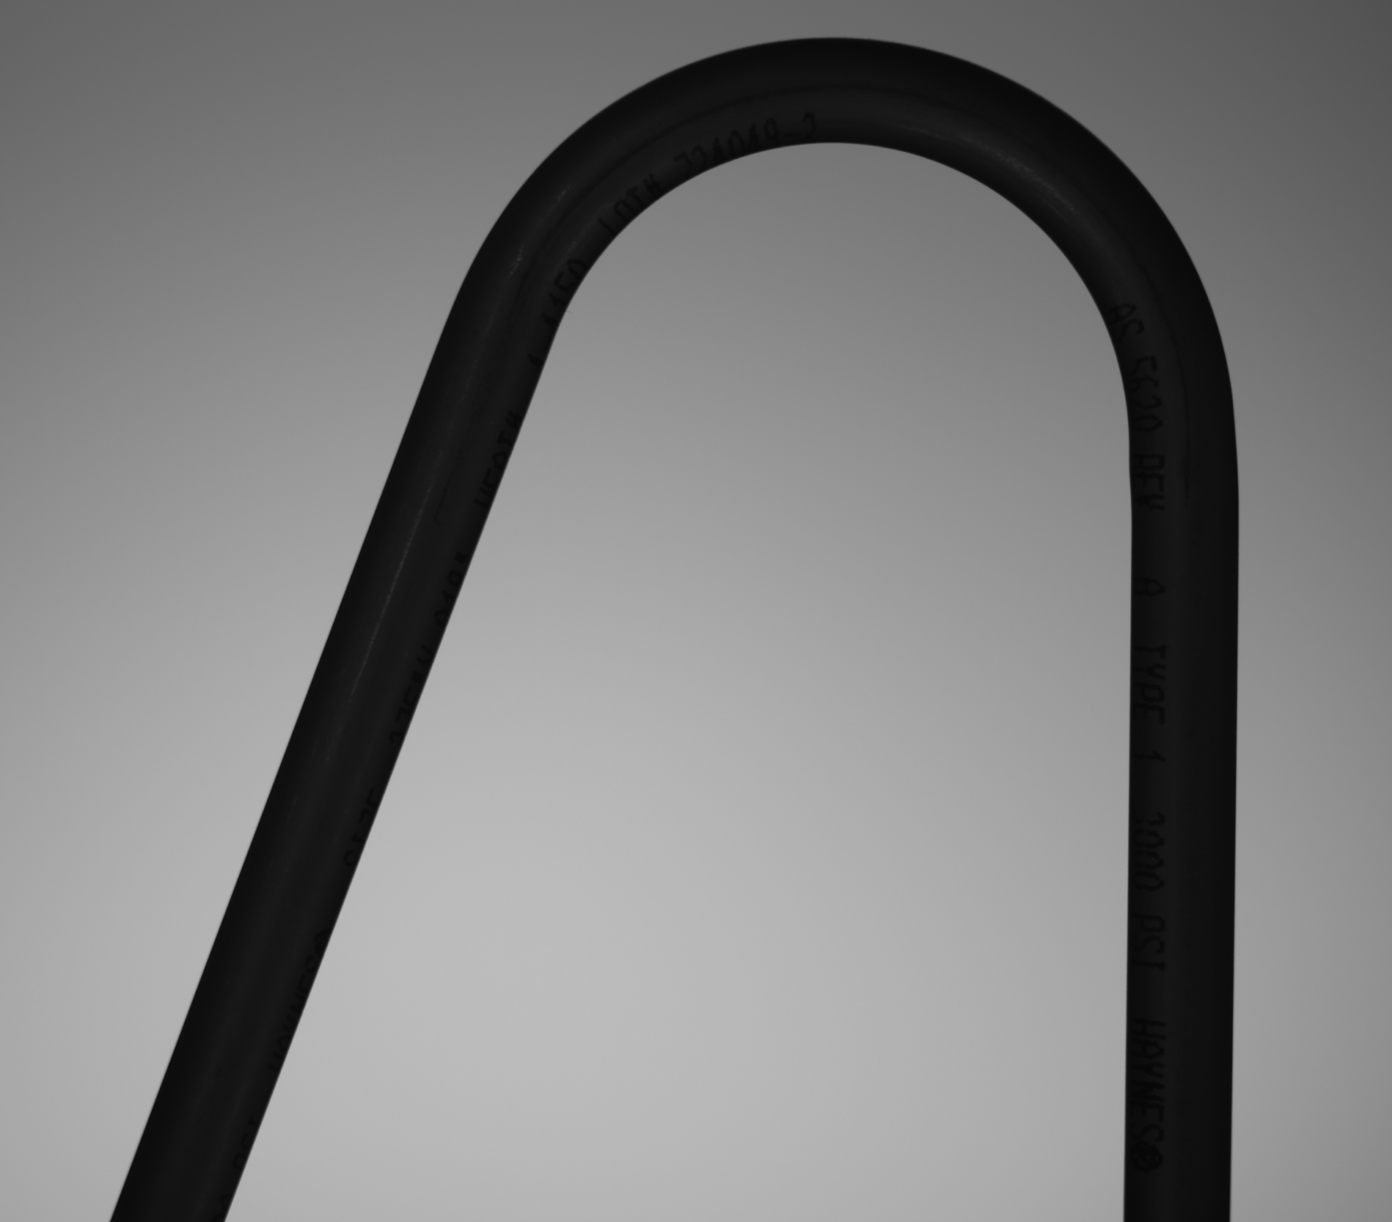
Previous Method
Image preprocessing. (subtraction, edge detection, etc)
Manually Separating the inner and outer edge from part 1.
Use Least square to fit all the data points to get the slope, transform to angle.
Part 1
Part 2

Slide 7
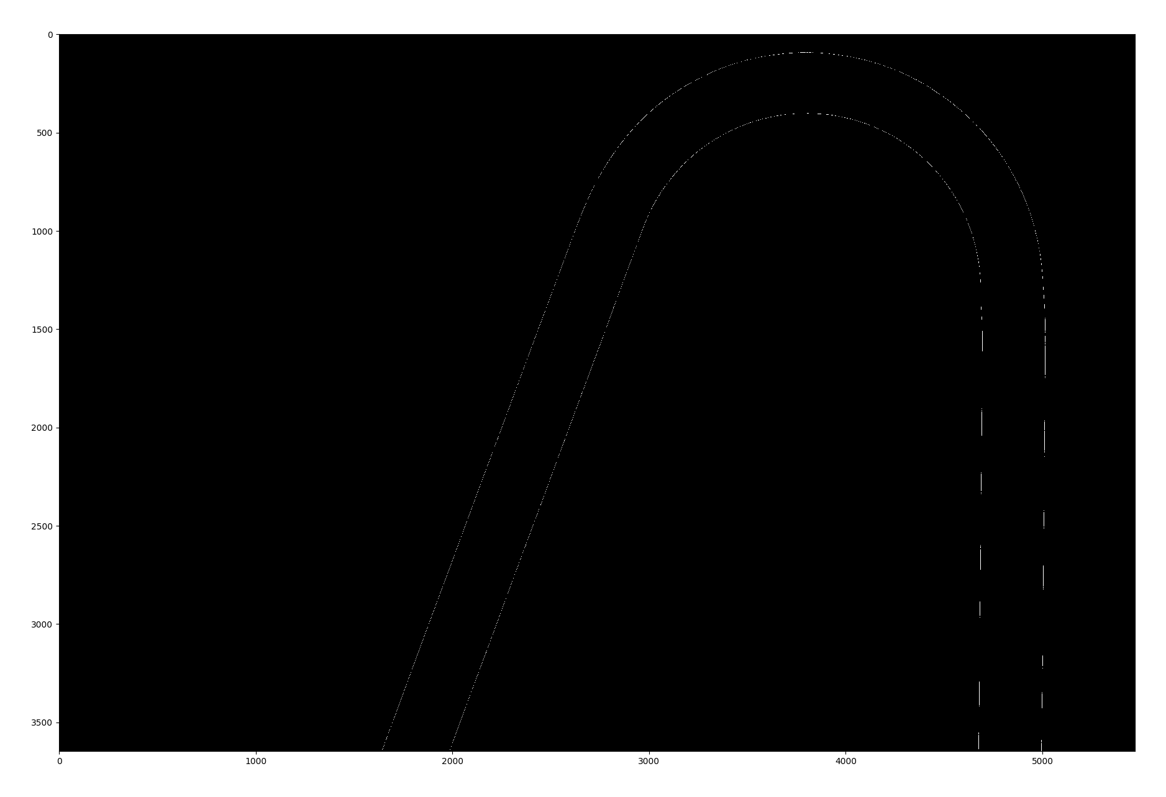
Previous Method
Image preprocessing. (subtraction, edge detection, etc)
16 cm * 10 cm

Slide 8
Previous Method
Image preprocessing. (subtraction, edge detection, etc)
Manually Separating the inner and outer edge from part 1.
Use Least square to fit all the data points to get the slope, transform to angle.
16 cm * 10 cm

Slide 9
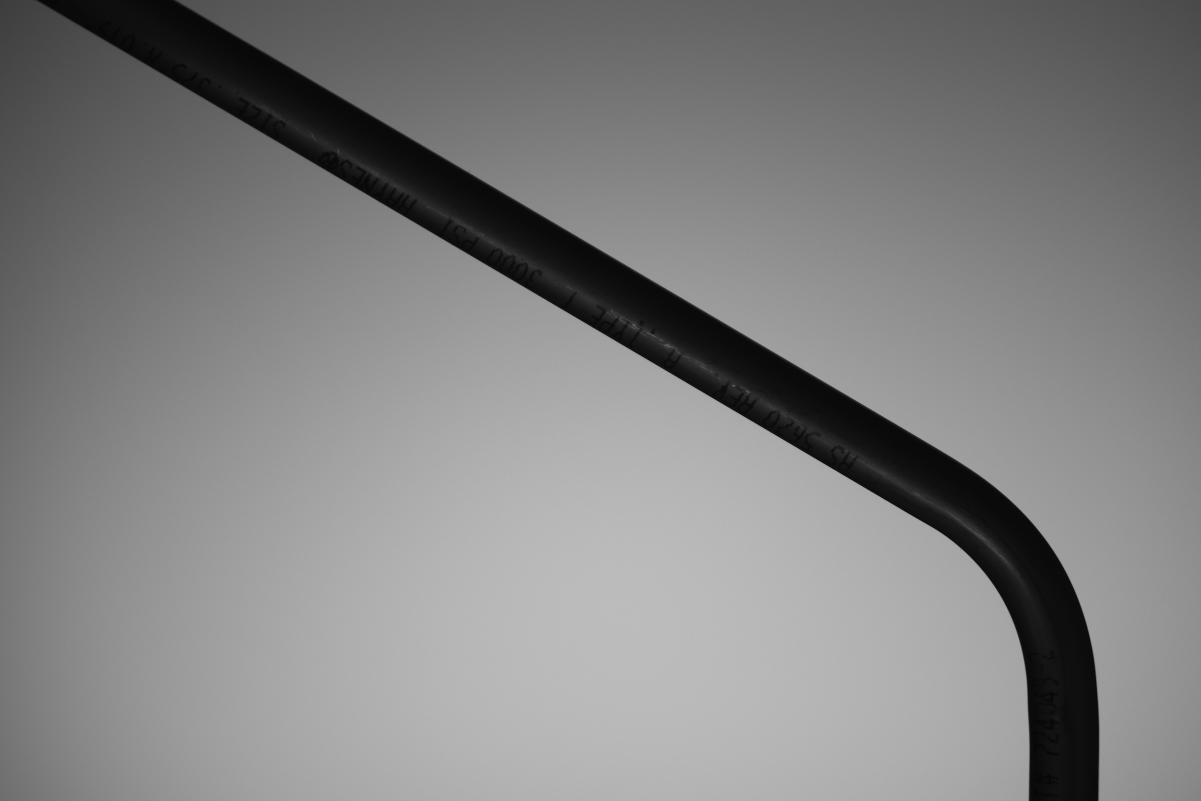
Previous Method
Image preprocessing. (subtraction, edge detection, etc)
Manually Separating the inner and outer edge from part 1.
Use Least square to fit all the data points to get the slope, transform to angle.
Assuming Part 2 is 90 degrees. (For some bends we need to capture more data points for Part 1)
Use these two angles to calculate the bending angle (or closed angle).
Part 1
Part 2

Slide 10
New Method
Image preprocessing. (subtraction, edge detection, etc)
Use HoughLines method to automatically find the straight lines. https://docs.opencv.org/master/d9/db0/tutorial_hough_lines.html
Process the HoughLines output and calculate the angle for both part1 and part2.
16 cm * 10 cm

Slide 11
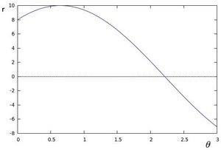
New Method
HoughLine explanation:
For a point (x, y), define the family of lines that goes through that point as:
r = x·cos θ + y·sin θ

Slide 12
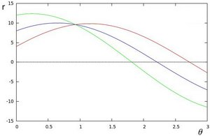
New Method
HoughLine explanation:
For a point (x, y), define the family of lines that goes through that point as:
r = x·cos θ + y·sin θ
Do the same operation above for all the points in an image. If the curves of two different points intersect, that means that both points belong to a same line.

Slide 13
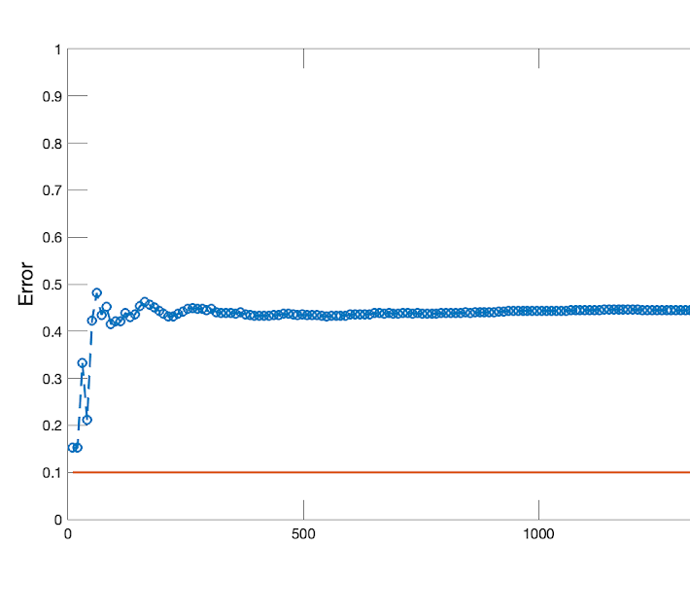
Previous Result Reviewed
Errors are above 0.4 for all the 8 bends
However all the errors are around 0.4

Slide 14
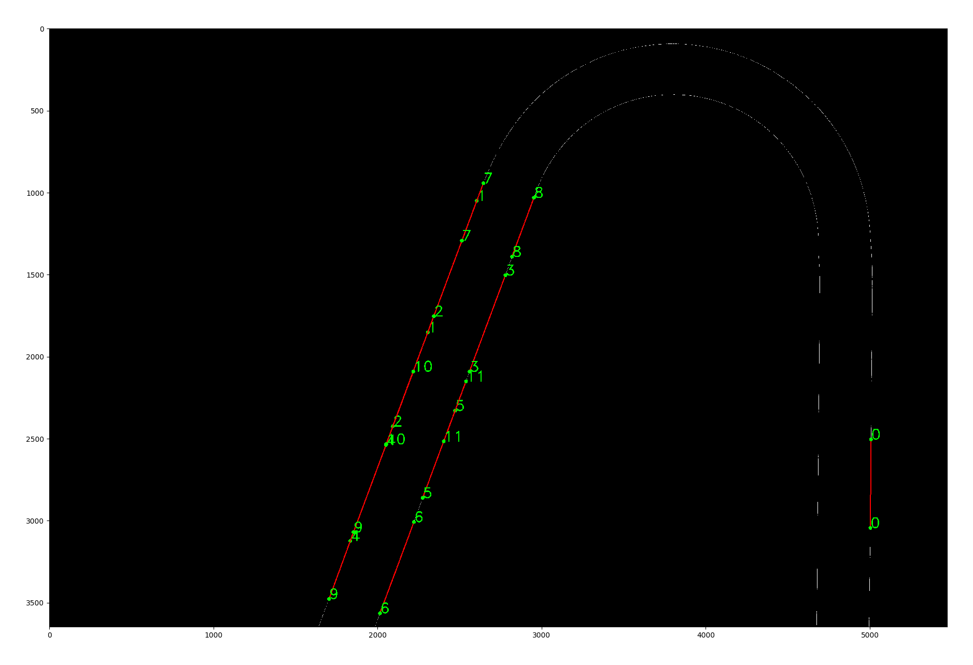
Previous Result Reviewed
Errors are above 0.4 for all the 8 bends
However all the errors are around 0.4
Could be Part 2 not 90 degrees
Try the new method and the errors are
tube 1: -0.068
tube 2: 0.053
tube 3: -0.033
tube 4: 0.057
tube 5: 0.039
tube 6: 0.100
tube 7: 0.015
tube 8: -0.056
16 cm * 10 cm

Slide 15
Current Week
Calibrated the frame, camera holder and the tube horizontal position.
Take images with 2k camera at 42 inches height.
Use the new method and the errors are
tube 1: -0.024
tube 2: 0.098
tube 3: 0.004
tube 4: 0.063
tube 5: -0.012
tube 6: 0.026
tube 7: 0.005
tube 8: -0.029

Slide 16
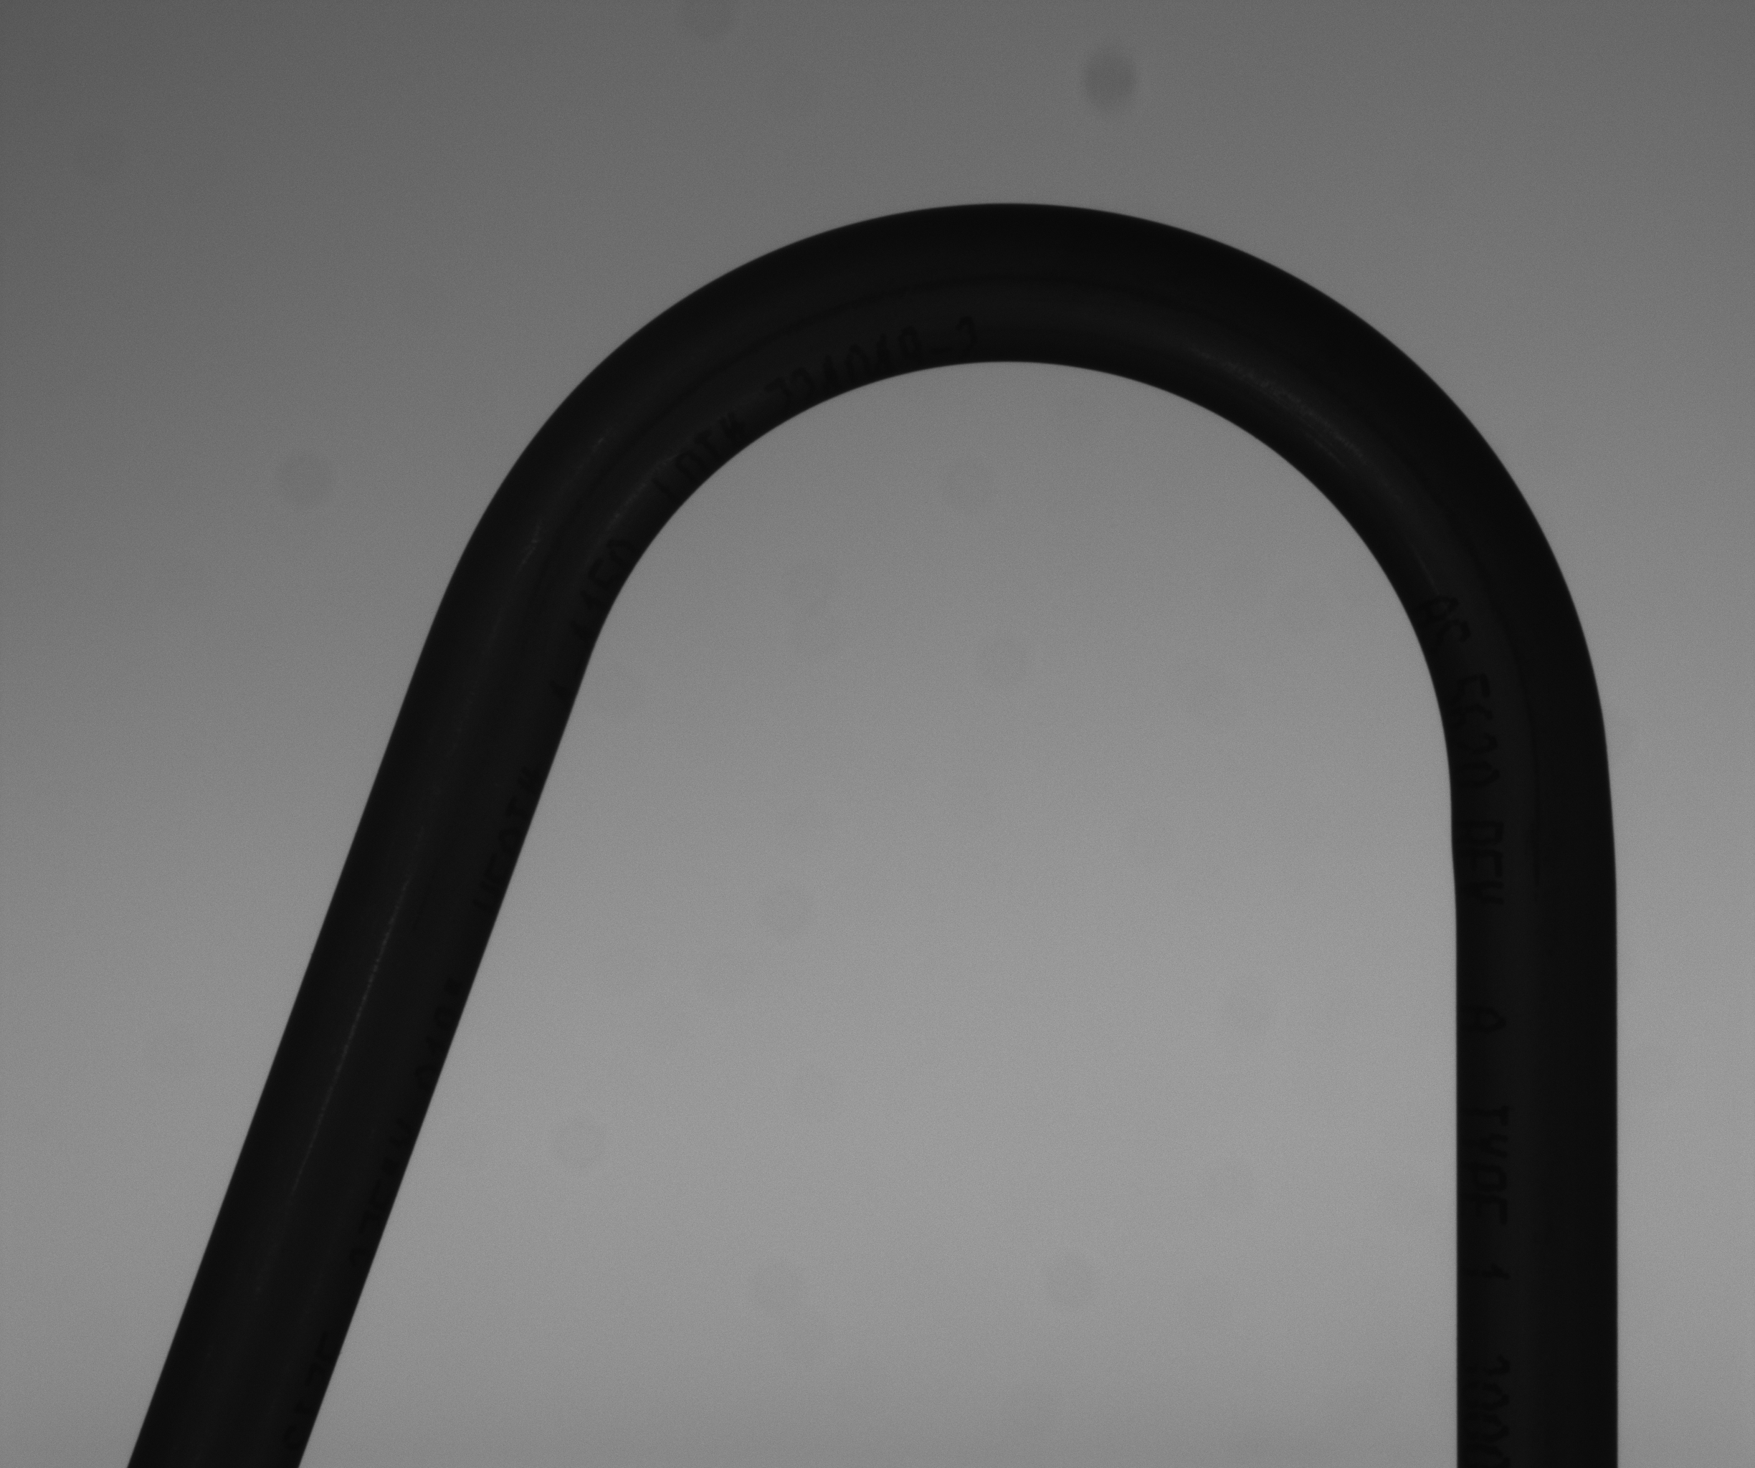
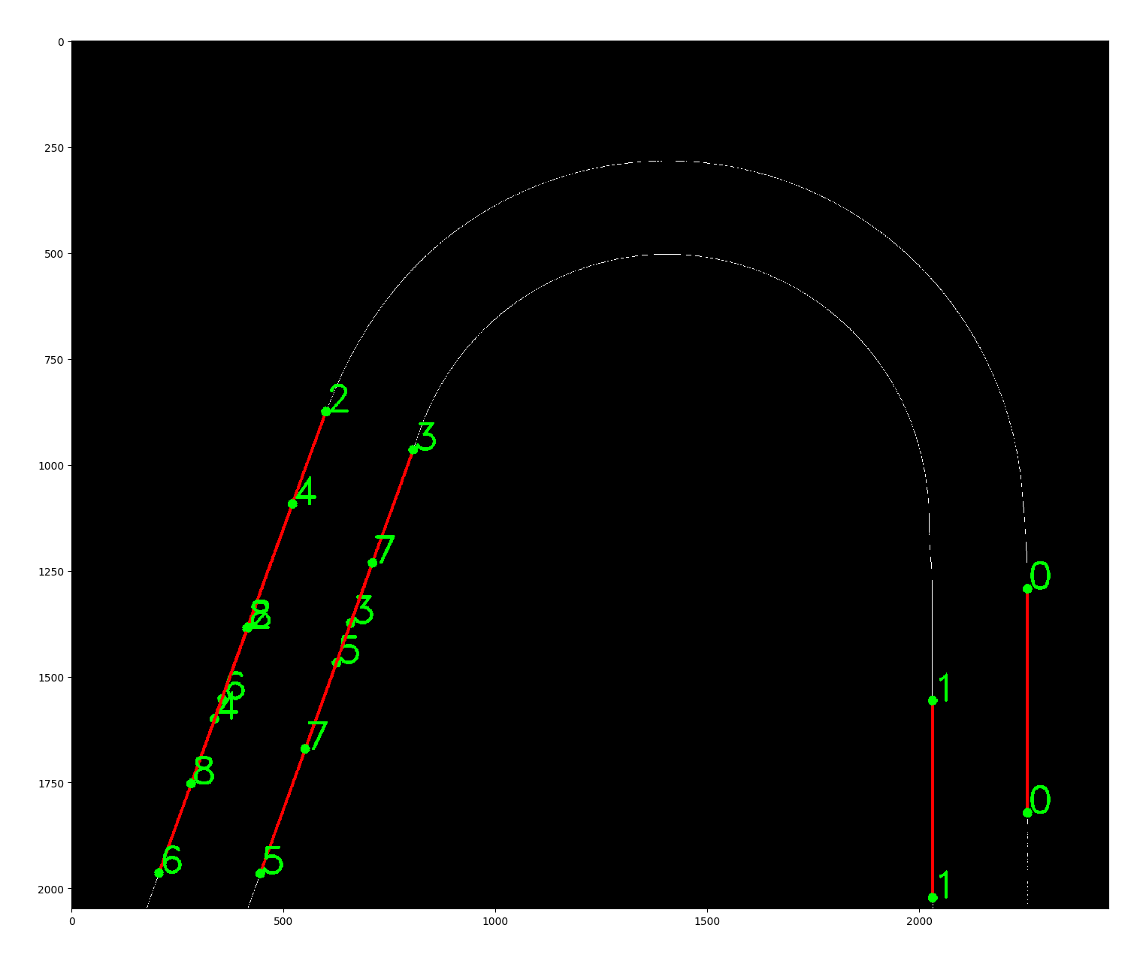
Results for Error
Tube 1: -0.024
10 cm * 8 cm

Slide 17
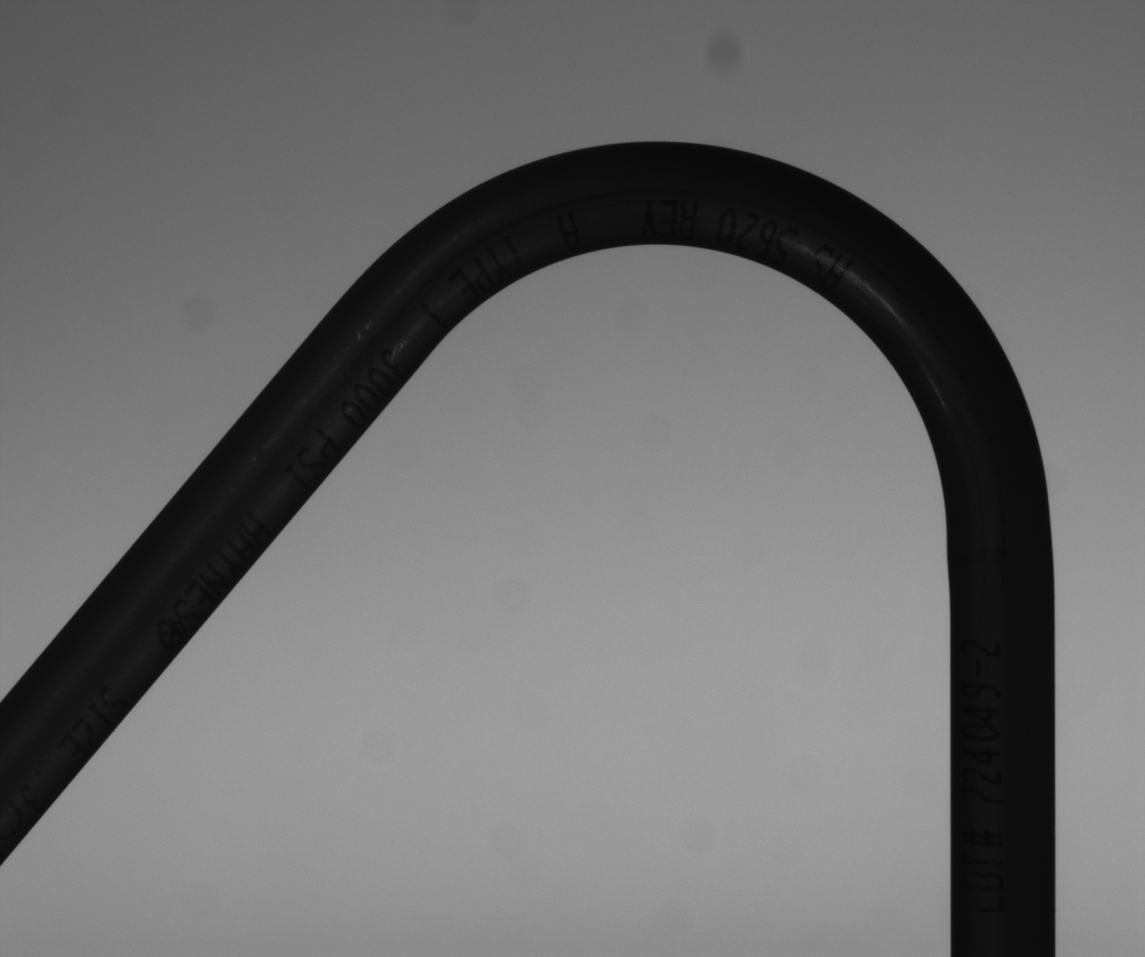
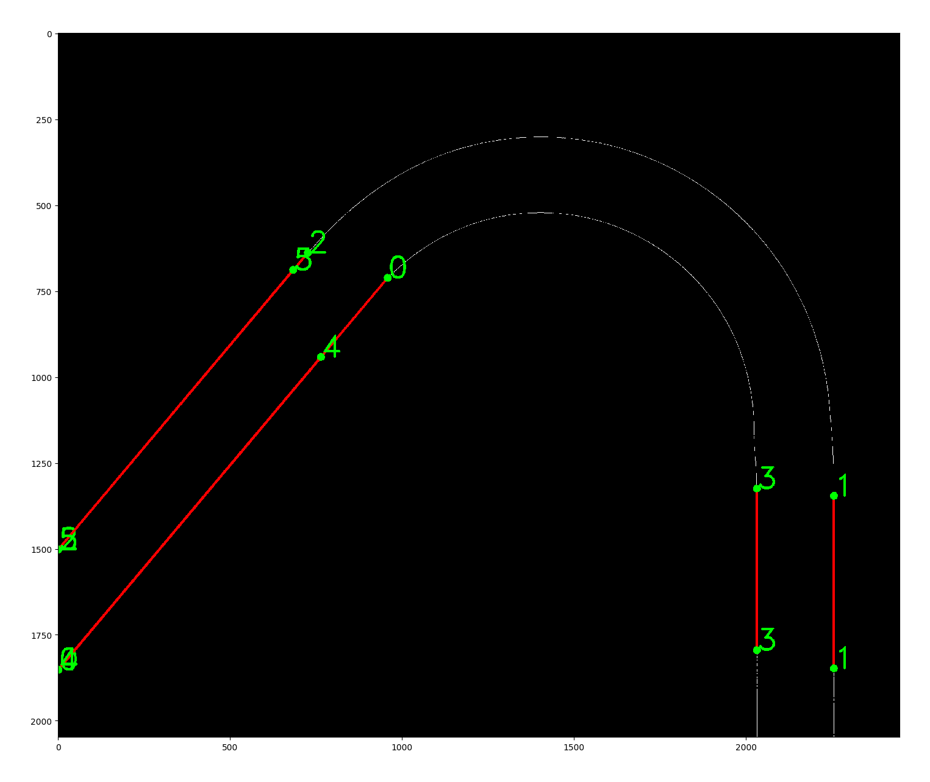
Results for Error
Tube 2: 0.098
10 cm * 8 cm

Slide 18
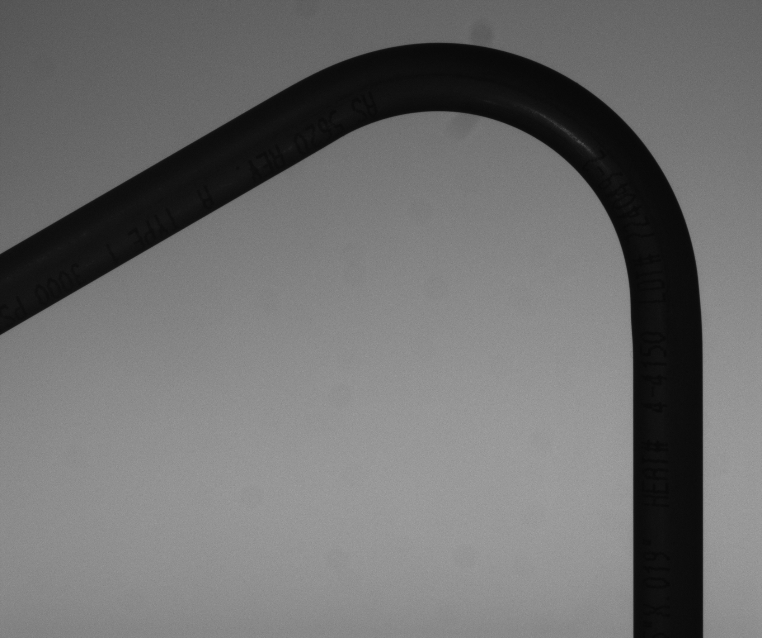
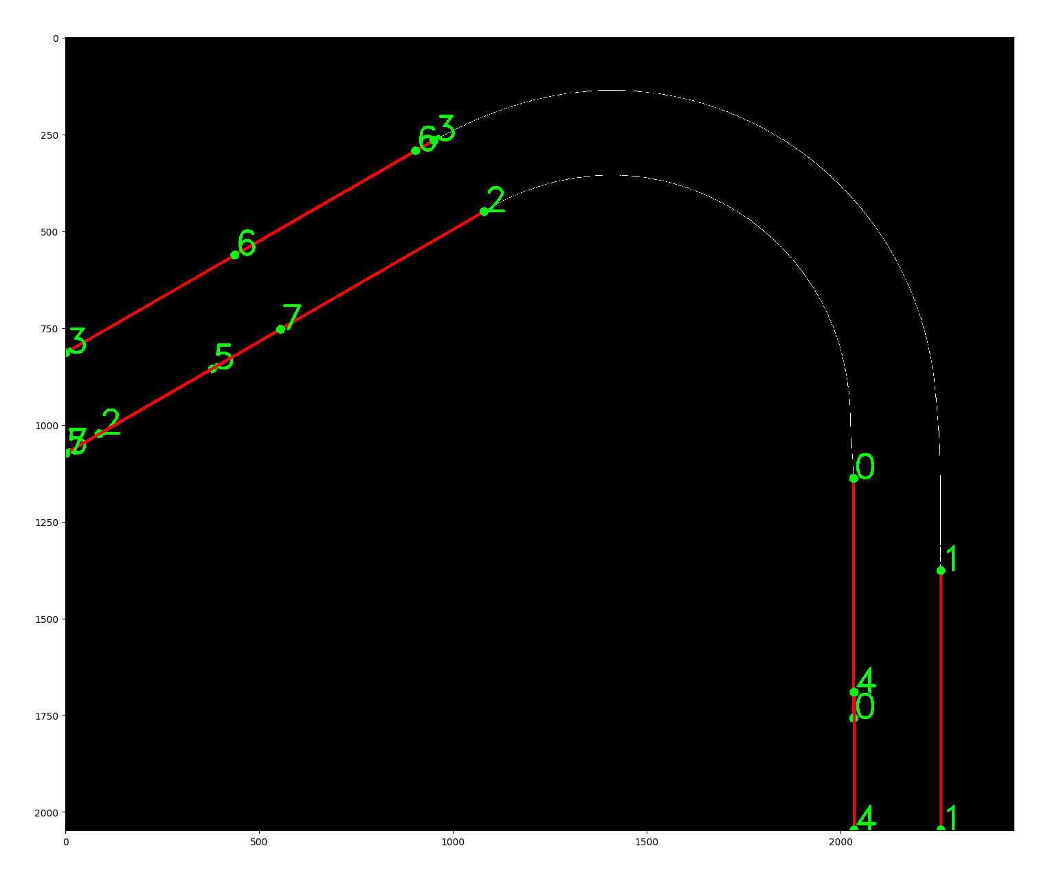
Results for Error
Tube 3: 0.004
10 cm * 8 cm

Slide 19
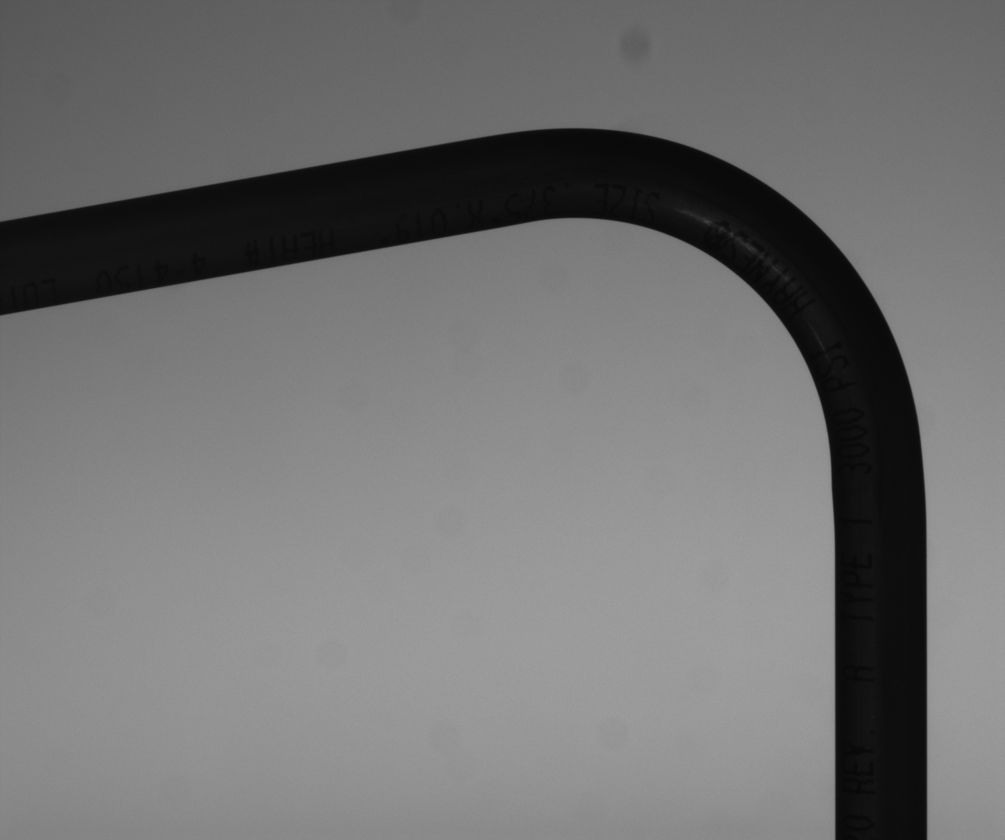
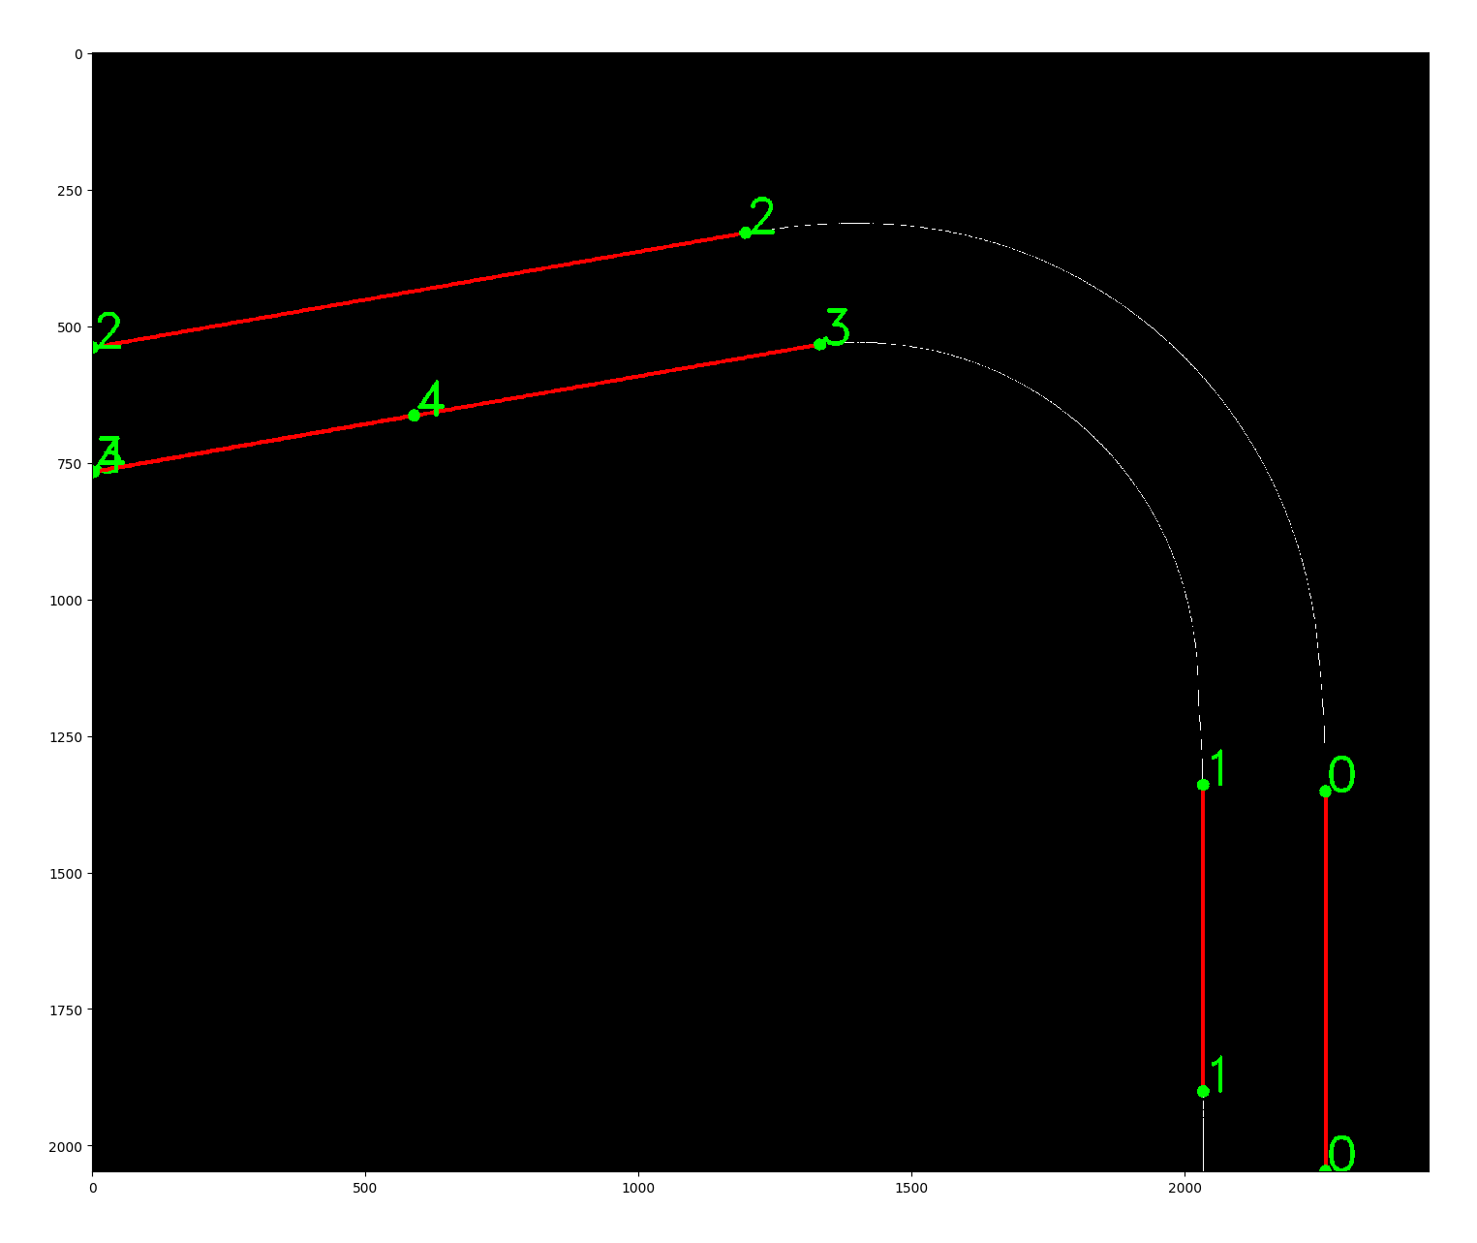
Results for Error
Tube 4: 0.063
10 cm * 8 cm

Slide 20
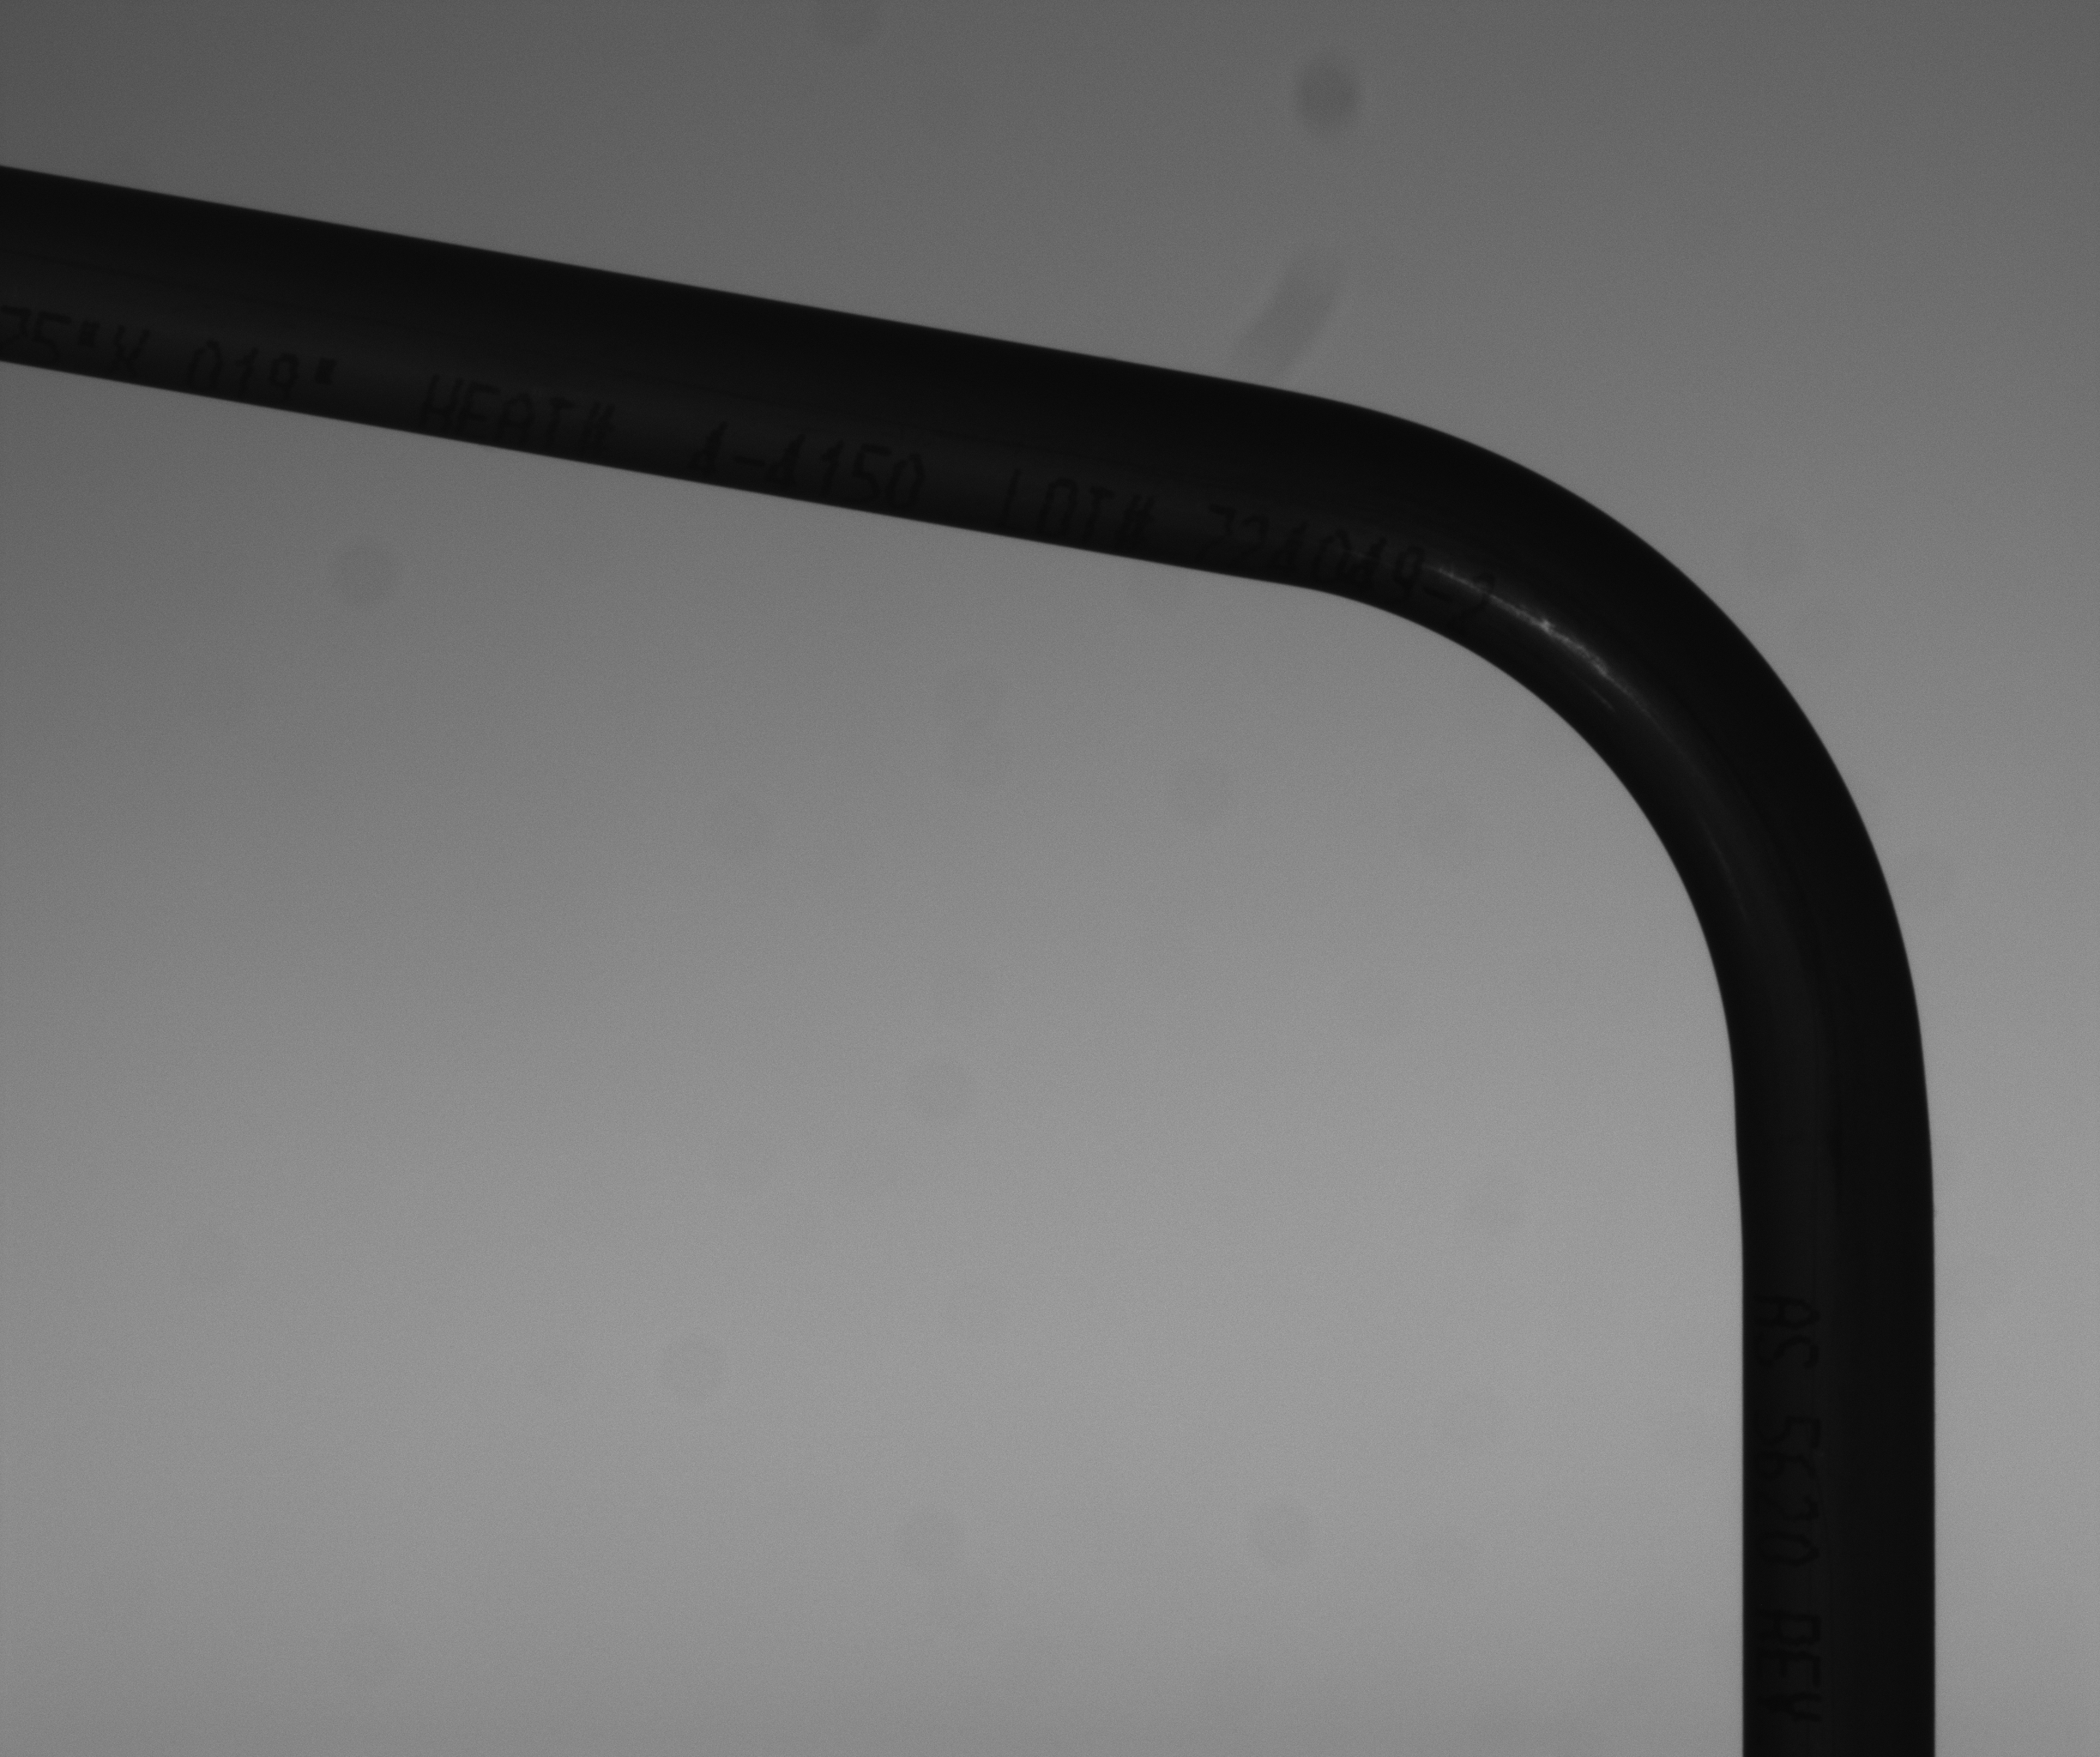
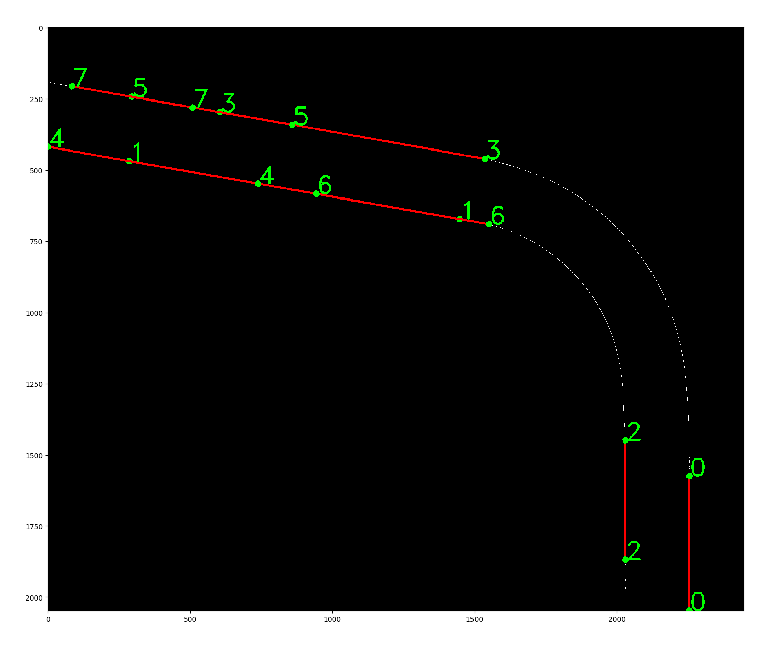
Results for Error
Tube 5: -0.012
10 cm * 8 cm

Slide 21
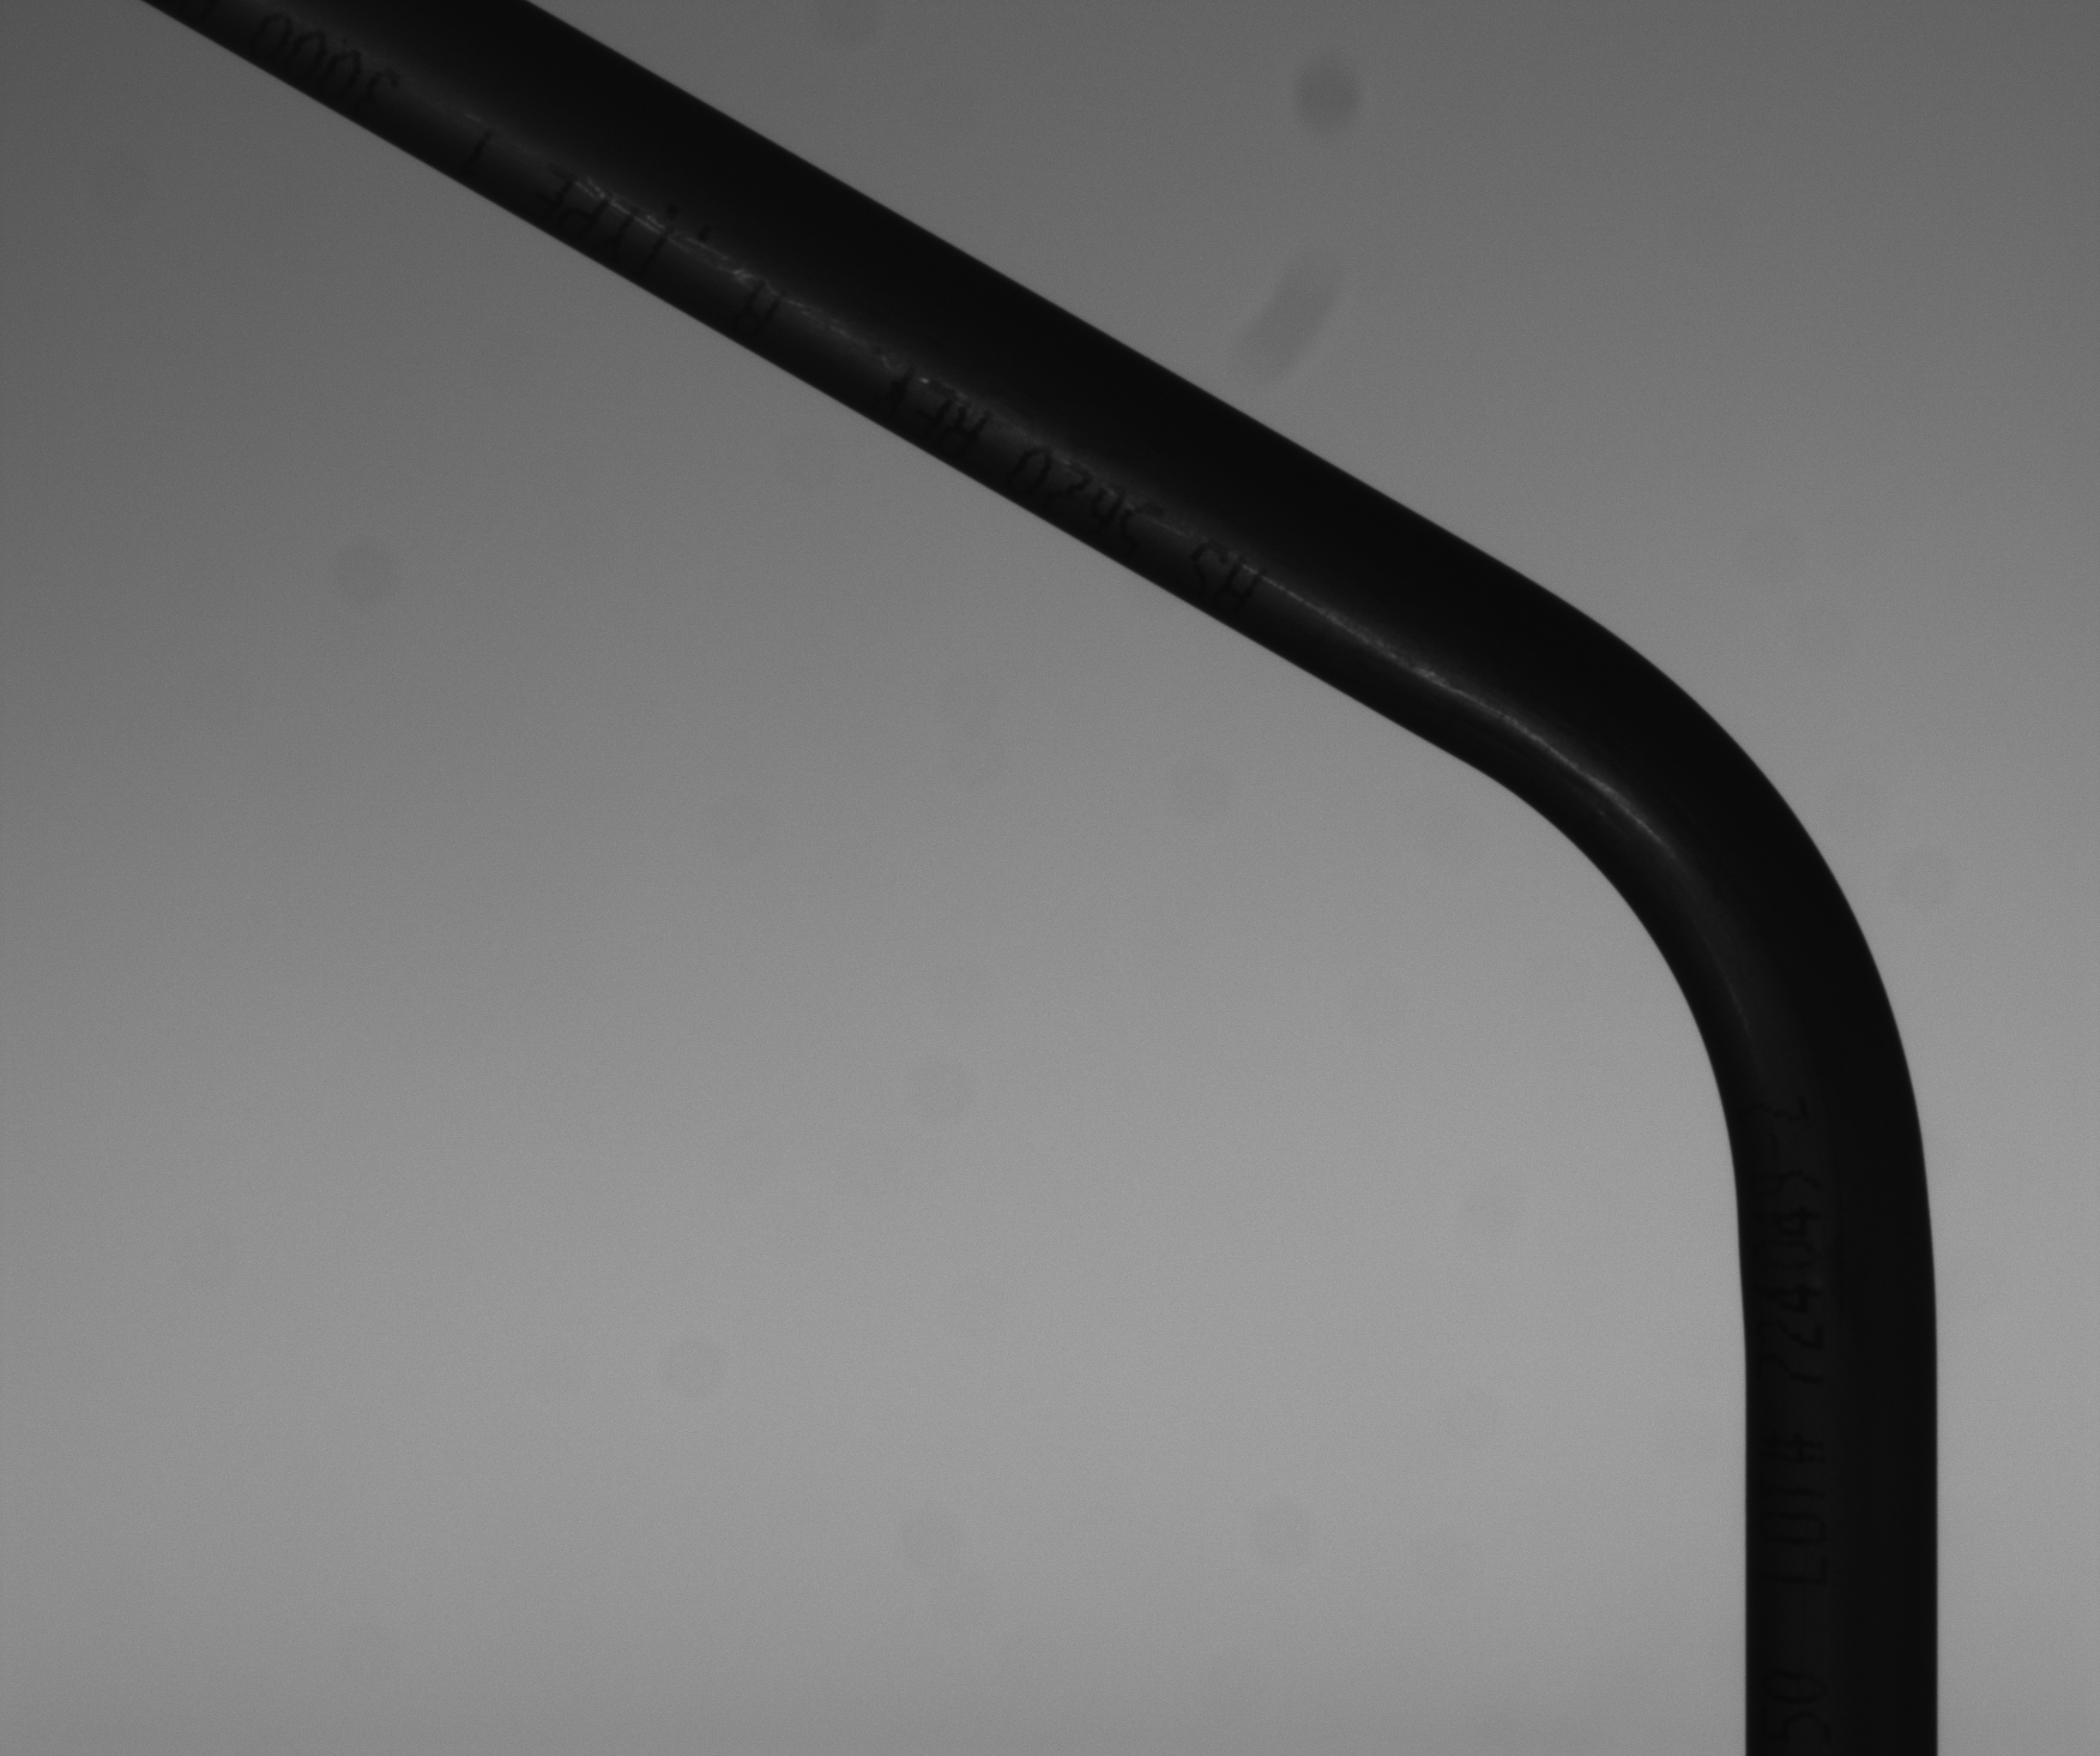
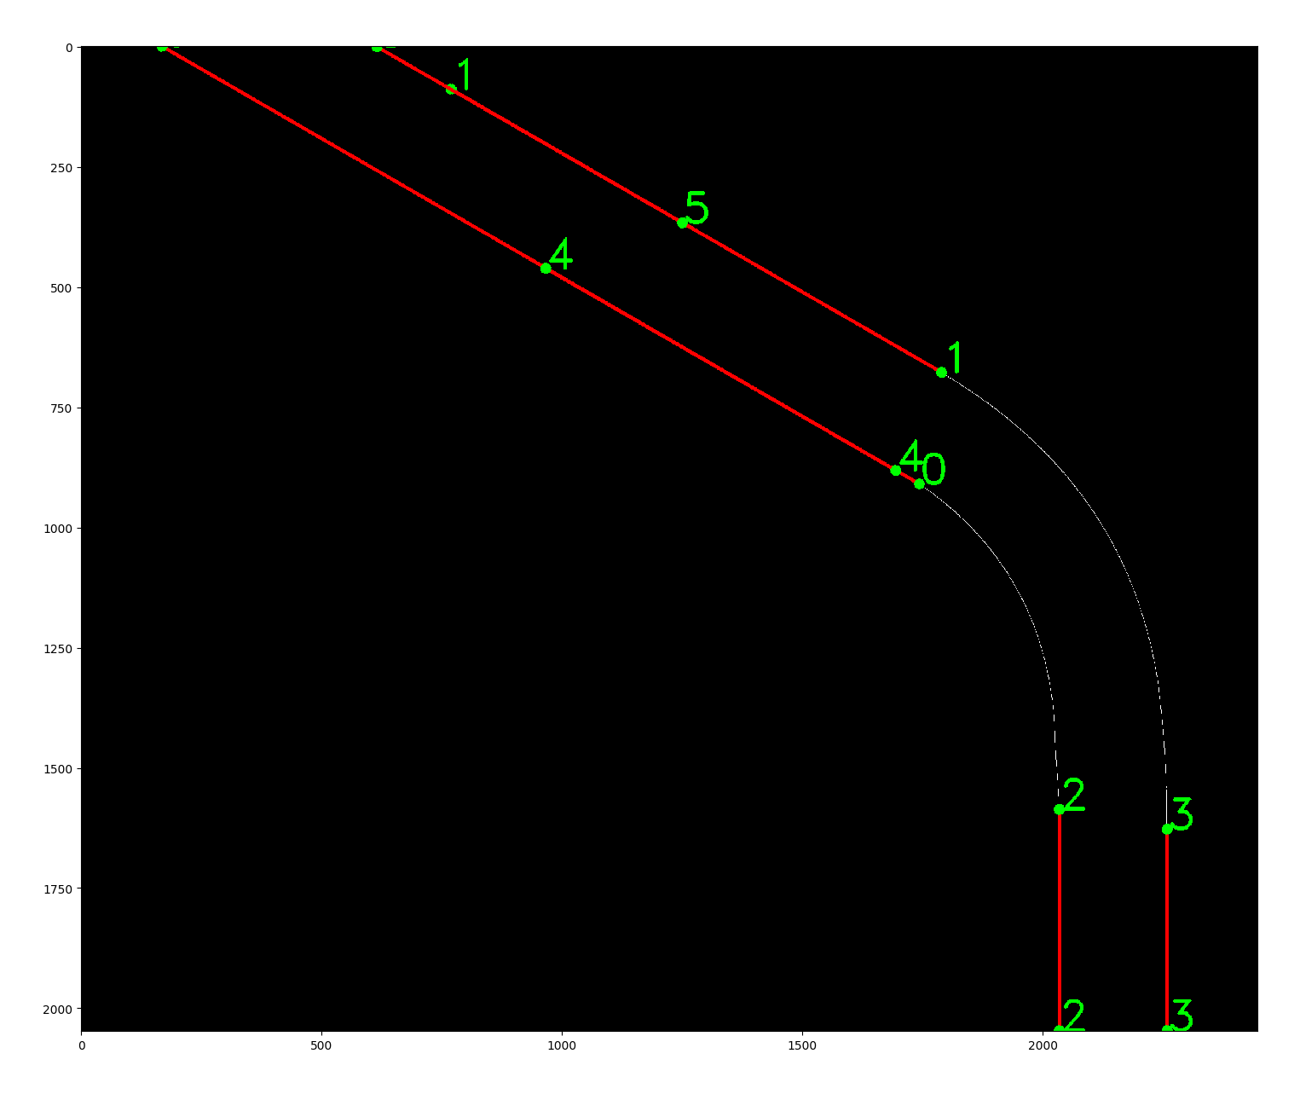
Results for Error
Tube 6: 0.026
10 cm * 8 cm

Slide 22
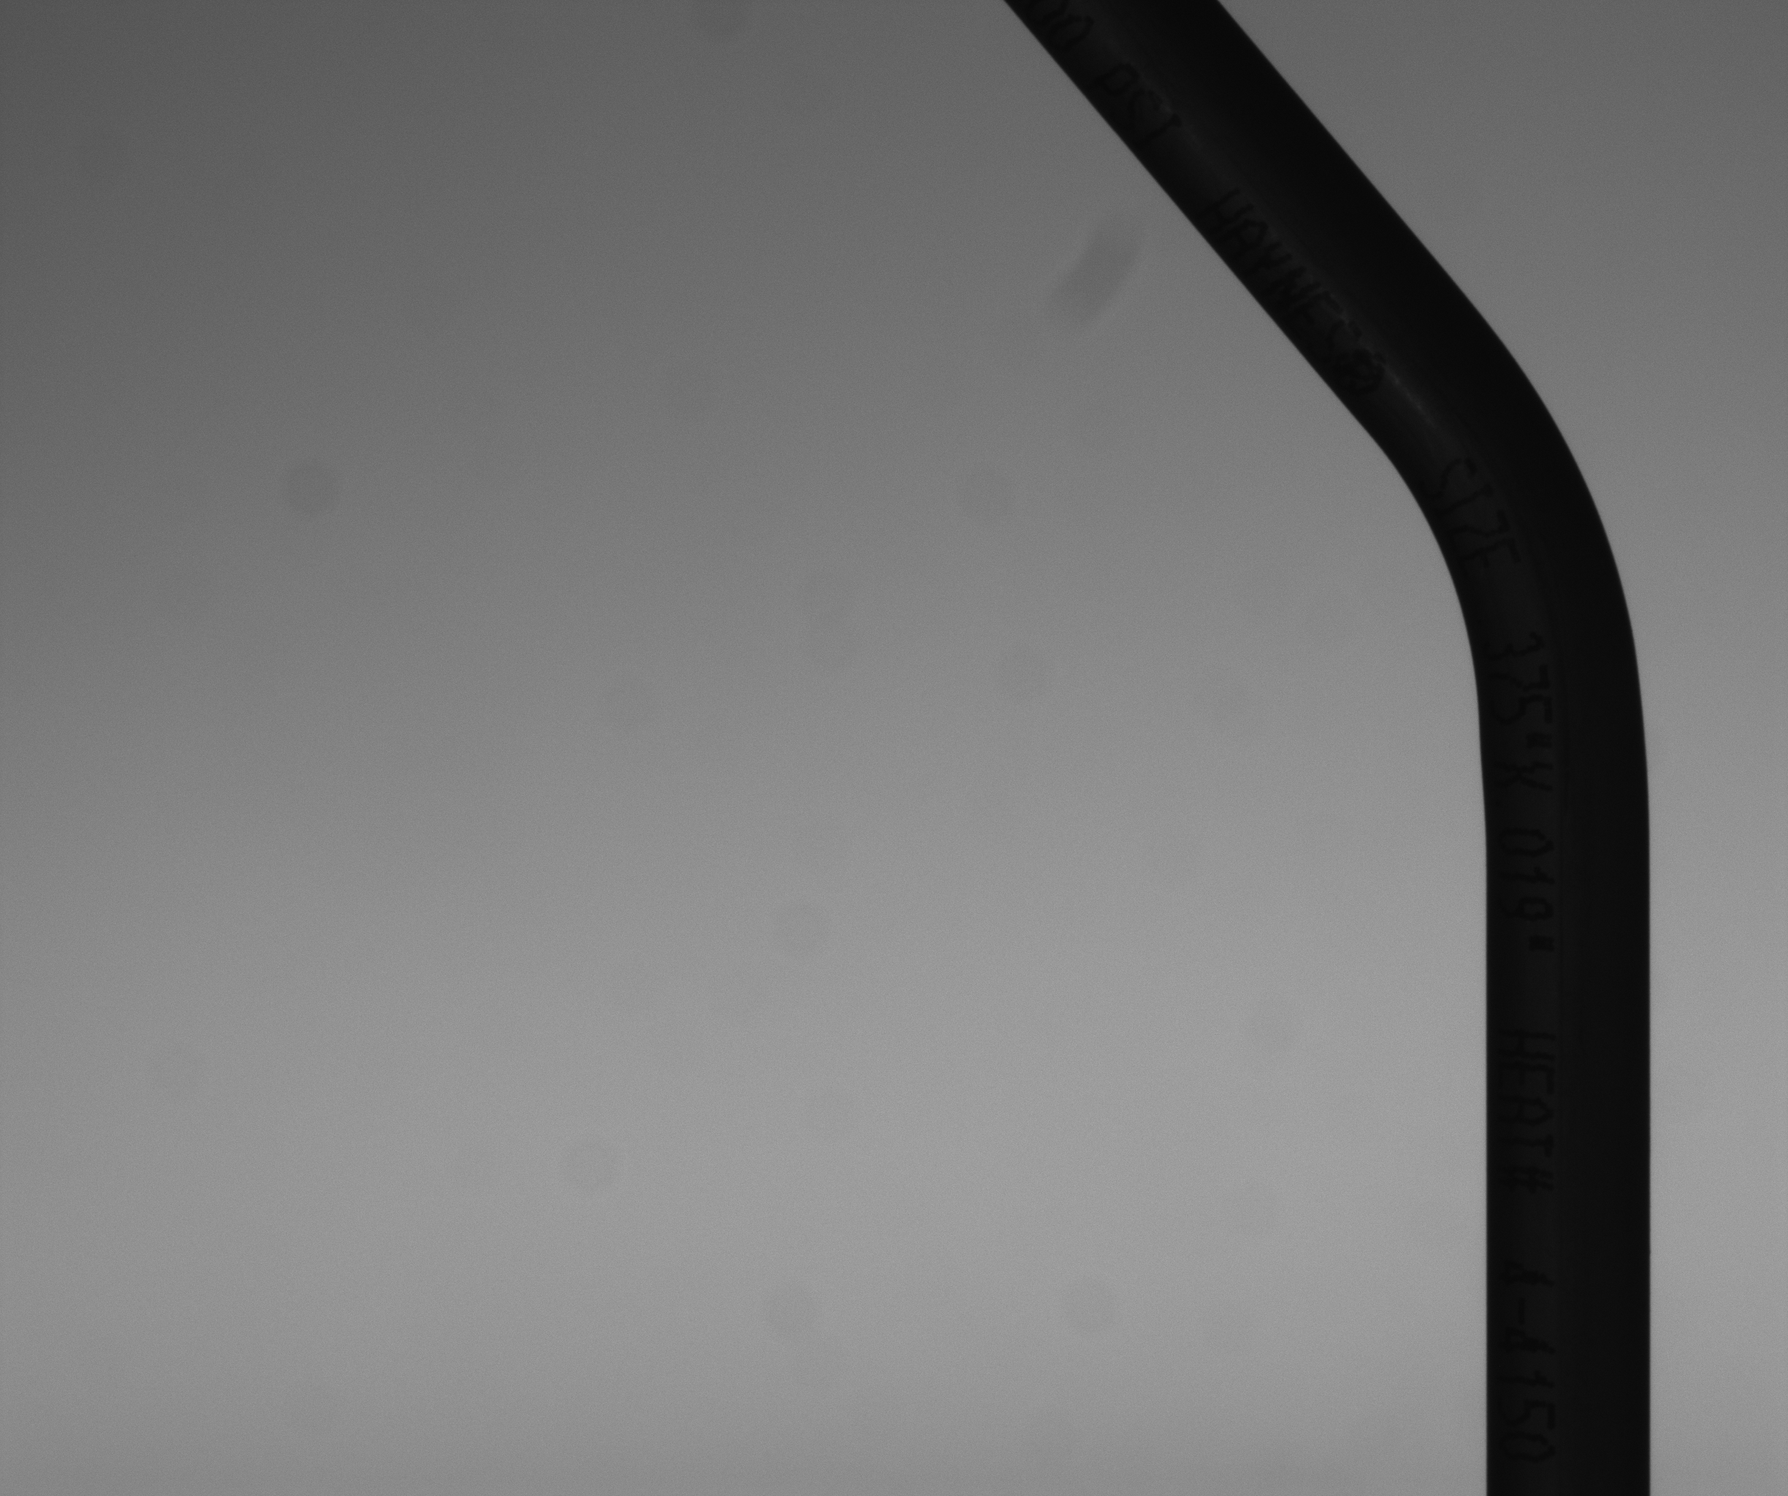
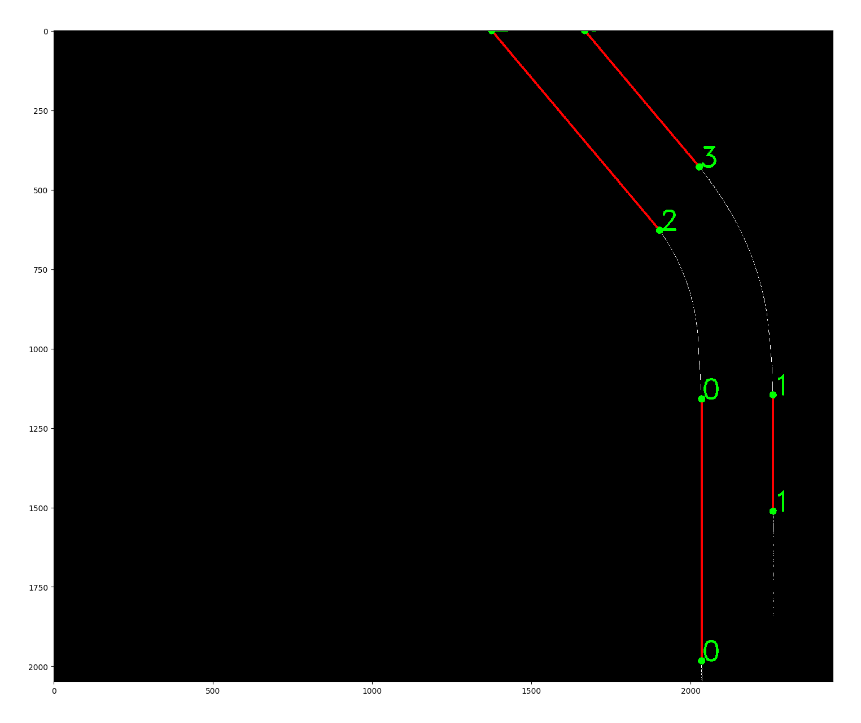
Results for Error
Tube 7: 0.005
10 cm * 8 cm

Slide 23
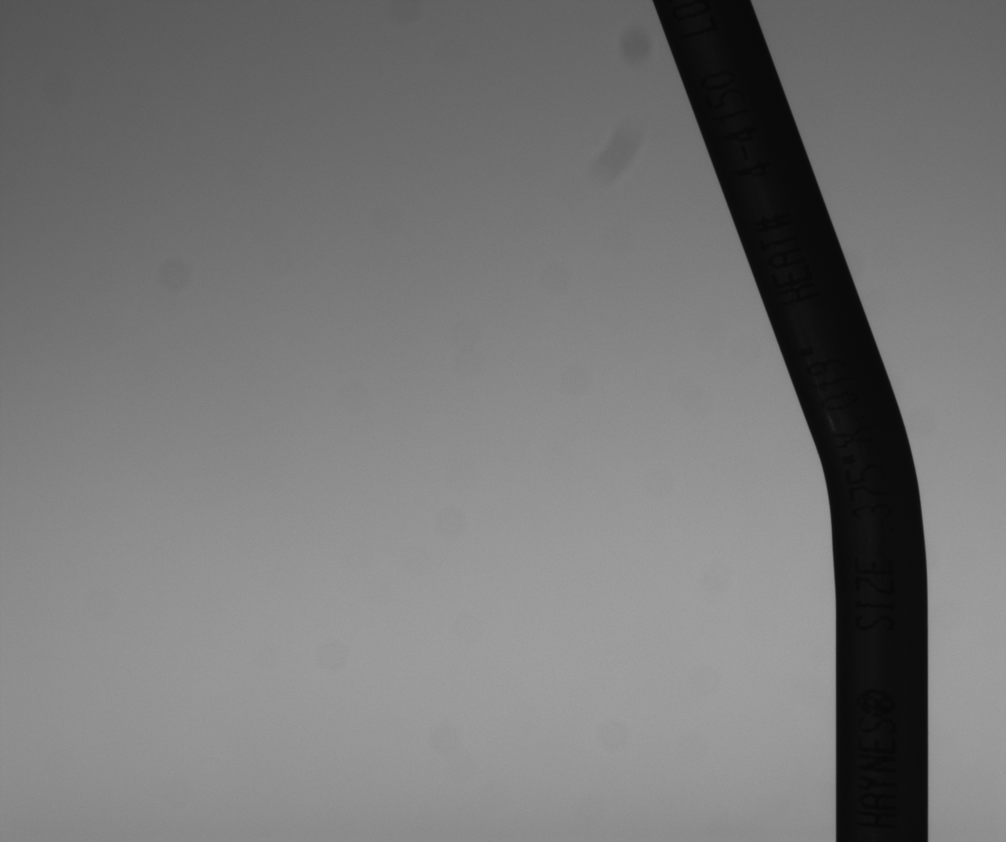
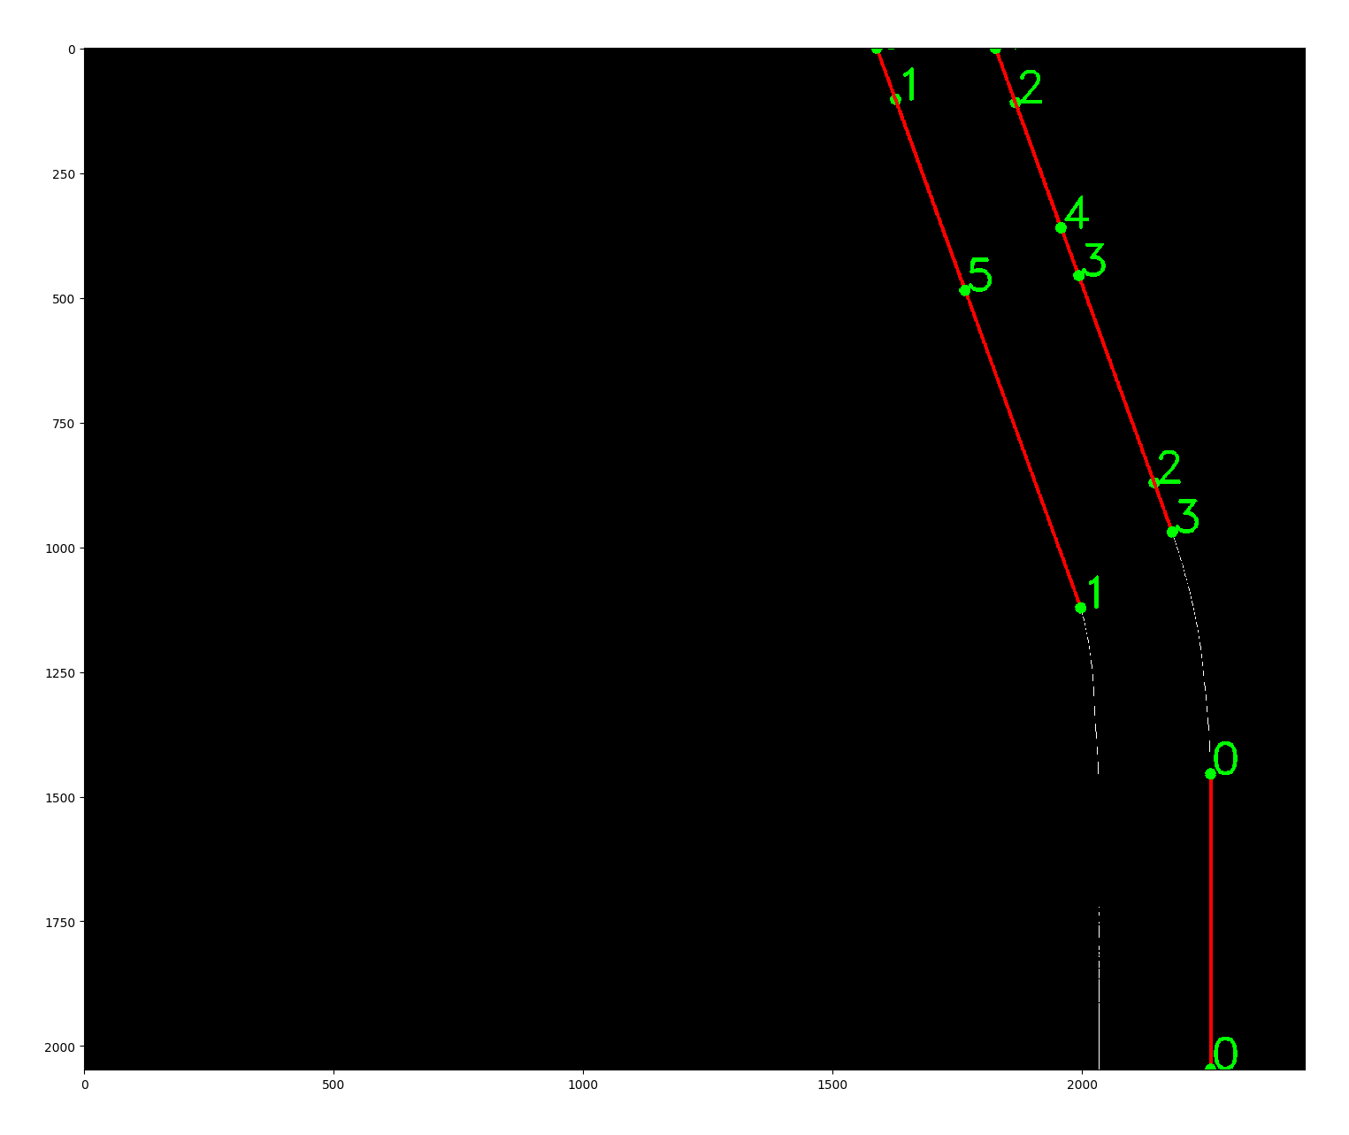
Results for Error
Tube 8: -0.029
10 cm * 8 cm

Slide 24
Insights
New method works for now. (8 tubes and both cameras)
HoughtLine method requires some parameters to specify the “quality” of the lines it can find. The current parameter works as long as the setting does not change too much.
The code is also automated right now, no need to manually find the separation points. Though change from Matlab to Python

Slide 25
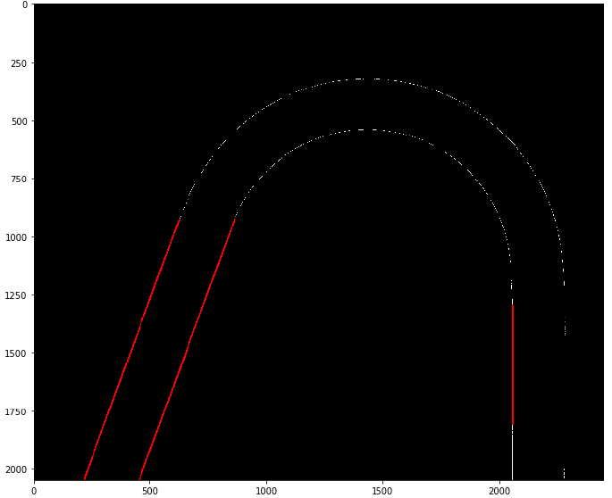
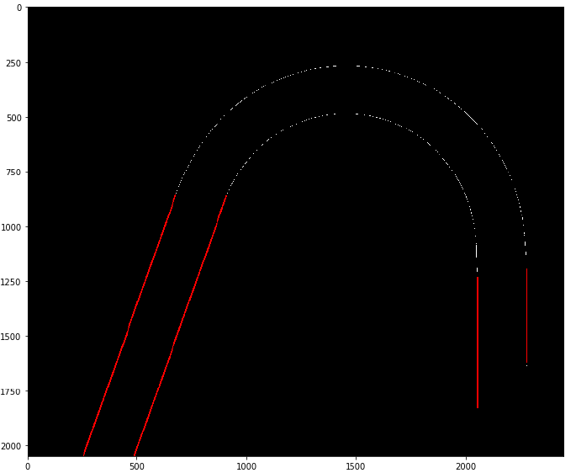
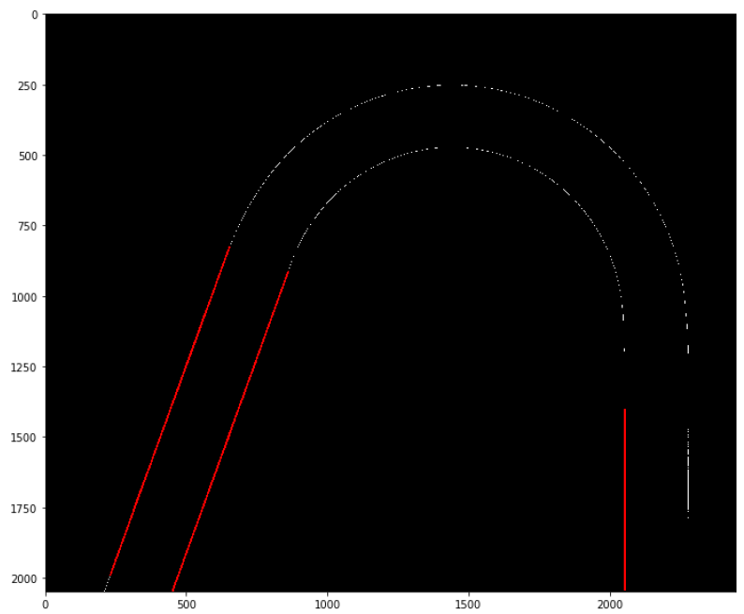
Tilted bend experiment (Bend 1)
Tilted down
Error : 0.4187
No Tilt
Error : -0.094
Tilted up
Error : -0.0494
10 cm * 8 cm

Slide 26
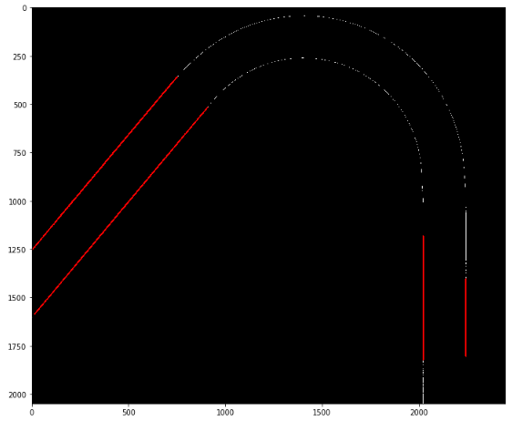
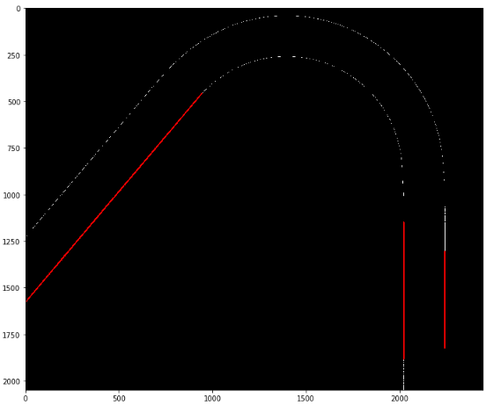
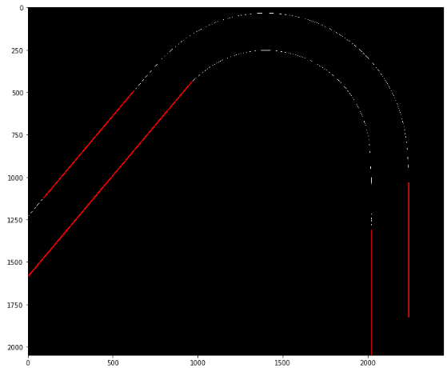
Tilted bend experiment (Bend 2)
Tilted down
Error : 0.1386
No Tilt
Error : 0.0642
Tilted up
Error : 0.0686
10 cm * 8 cm

Slide 27
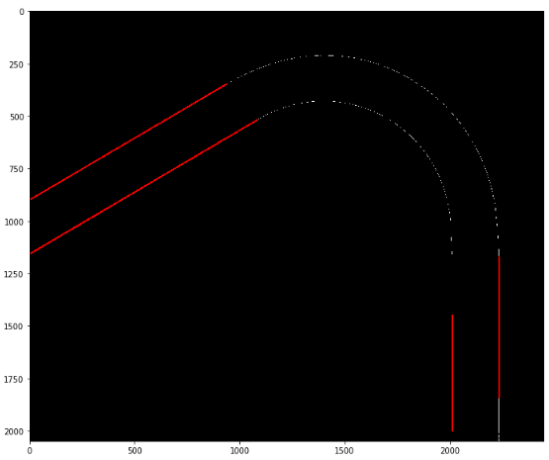
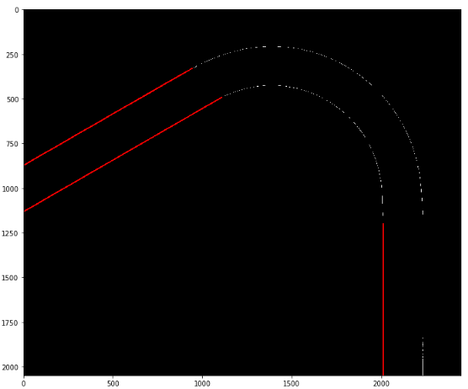
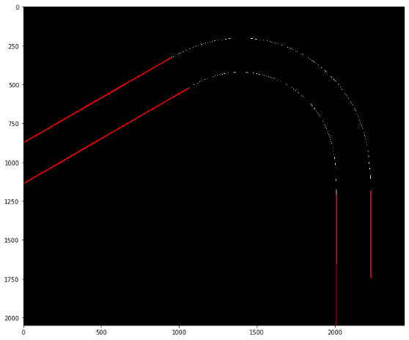
Tilted bend experiment (Bend 3)
Tilted down
Error : 0.4958
No Tilt
Error : -0.05506
Tilted up
Error : 0.0022
10 cm * 8 cm

Slide 28
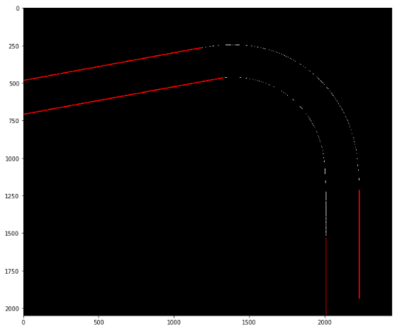
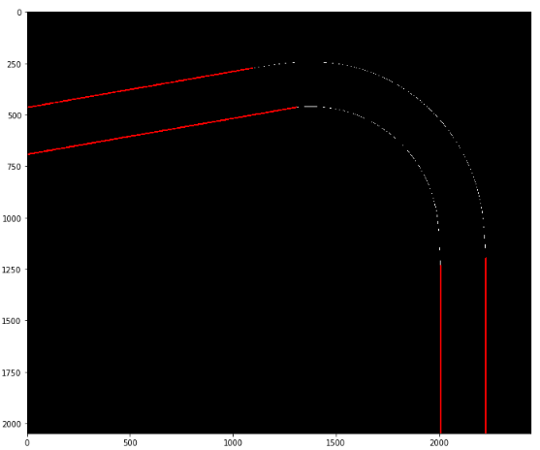
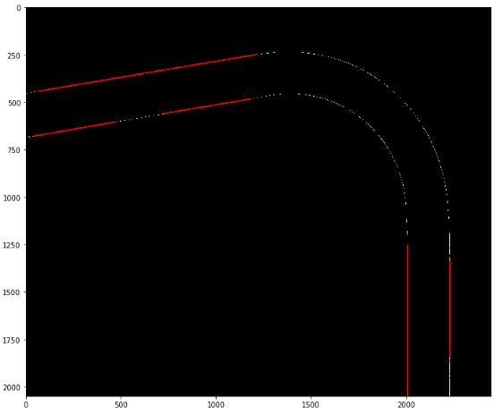
Tilted bend experiment (Bend 4)
Tilted down
Error : 0.5397
No Tilt
Error : 0.0522
Tilted up
Error : -0.27879
10 cm * 8 cm

Slide 29
Insights
Neutral orientation and upward tilt perform better in angle error is better than downward tilt probably because of sharper/more focus on the bend in those orientations.

Slide 30
Future work
We achieved errors below threshold error value after correcting the orientations using torpedo leveller.
We automated the process using houghlines and boundary conditions.
We now have to conduct the process for different varying conditions.

